Slide 1
Home Gardening and Nutrition Training Material
2
IMPROVE YIELDS
Increasing the production from your homestead garden
Notes:
By planning how we plant, we can increase our yields and protect our crops from pests and diseases. Compost making will enrich our soil and help us to improve our production in a sustainable manner.

Slide 2
1. Cropping methods
Four simple and effective cropping techniques:
Crop rotation
Intercropping
Succession planting
Companion planting
Notes:
There are several techniques to practice a sustainable cropping plan. Crop rotation, intercropping, succession planting and companion planting are the most simple and effective options to try out in your homestead garden.

Slide 3
1. a. Crop rotation
What is “Crop rotation”?
It is the practice of alternating different crops each season in the same plot.
Why doing crop rotations?
To optimize the amount of nutrients in the soil, hence increase yields.
To improve the quality of the soil, building up nutrients and preventing soil exhaustion.
To break the life cycle of pests and diseases.
See example in the next slide
Notes:
Crop rotation is the practice of alternating different crops each season in the same plot.
Different plants use soil nutrients at different rates and amounts (cabbage uses a lot of nutrients while green leafy crops need less). We need to rotate our crops so nutrients in the soil are optimized and yields are increased. Rotation improves the quality of our soils, building up nutrients and preventing soil exhaustion.
Crop rotation also breaks the life cycle of pests and diseases as they generally need a specific host plant family to live on and reproduce. By alternating the crops, the pests are prevented from establishing themselves in our soils. An example of crop rotation can be seen in the next slide.

Slide 4
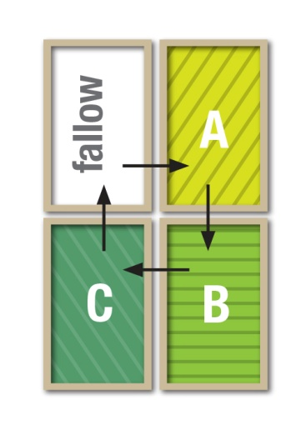
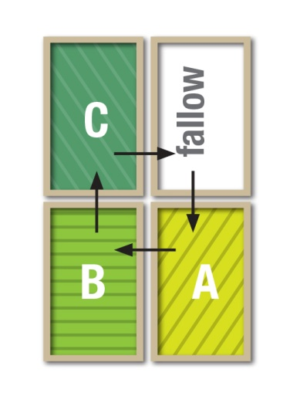
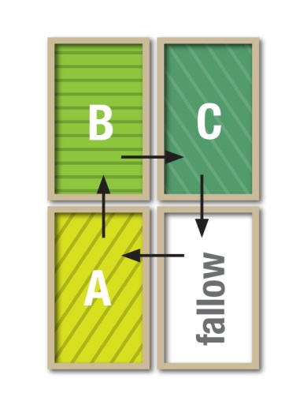
1. a. Crop rotation
Example: Divide your garden in four sections. Move the vegetable groups each following year in the next quarter of the garden (see below). It keeps the soil fertile and the plants healthy and vigorous.
Year 1
Year 2
Year 3
Year 4
You can plant together:
Onion and garlic
Carrot, beetroot, turnip
Tomato, lettuce, spinach
Beans, peas
Notes:
A garden can be divided into 4 sections, shown here as A, B & C with one section left fallow (not planted so that soil can rest).
The following groups of vegetables can be grown together in the different sections of the garden:
Onion and garlic
Carrot, beetroot, turnip
Tomato, lettuce, spinach
Beans, peas
Each following year move the vegetable groups into the next quarter of the garden so that each group of vegetables is grown in the soil used by another group the previous year. This rotation keeps the soils fertile and the plants healthy and vigorous. A different section gets to rest every year.

Slide 5
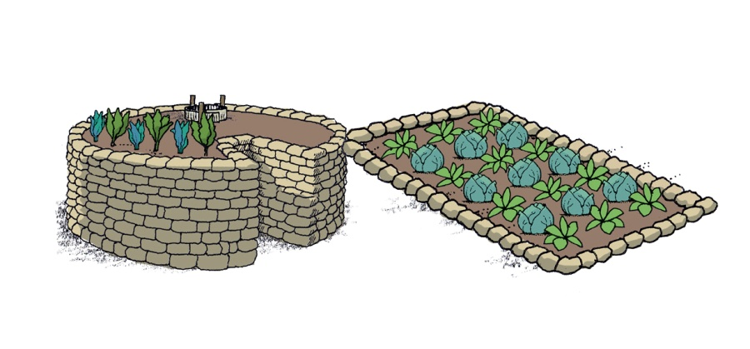
1. b. Intercropping
What is “Intercropping”?
It is the practice of planting more than one crop together.
Why doing “Intercropping”?
To improve crop fertility and water use
To reduce pests and diseases
Advice for better results when intercropping
Keyhole garden: leafy crops such as spinach, rape, carrots, beetroot
Trench garden: root crops such as cabbage, tomato, peas, beans
Notes:
Intercropping is the practice of planting more than one crop together.
Intercropping improves crop fertility and water use. Intercropping reduces pests and diseases (examples of good companion plants are presented below). It is advised to intercrop leafy and root crops in the keyhole garden plot (e.g. spinach, rape, carrots, beetroot) while a trench garden plot is more adequate for crops that would take too much space in the keyhole or could damage it (e.g. cabbage, tomato, peas, beans).

Slide 6
1. c. Succession planting
What is “Succession planting”?
It is the practice of planting seeds in intervals of few weeks instead of planting all seeds at the same time.
Why doing “Succession planting”?
It ensures continuous supply of a particular crop instead of having all crops ripening at the same time.
Notes:
Succession Planting is the practice of planting seeds in intervals of few weeks during the planting season instead of planting all seeds at the same time. Succession Planting is a good way of ensuring you have a continuous supply of a particular vegetable over the course of the season instead of having all crops ripening at the same time for a short period. See planting calendar in Poster 3.

Slide 7
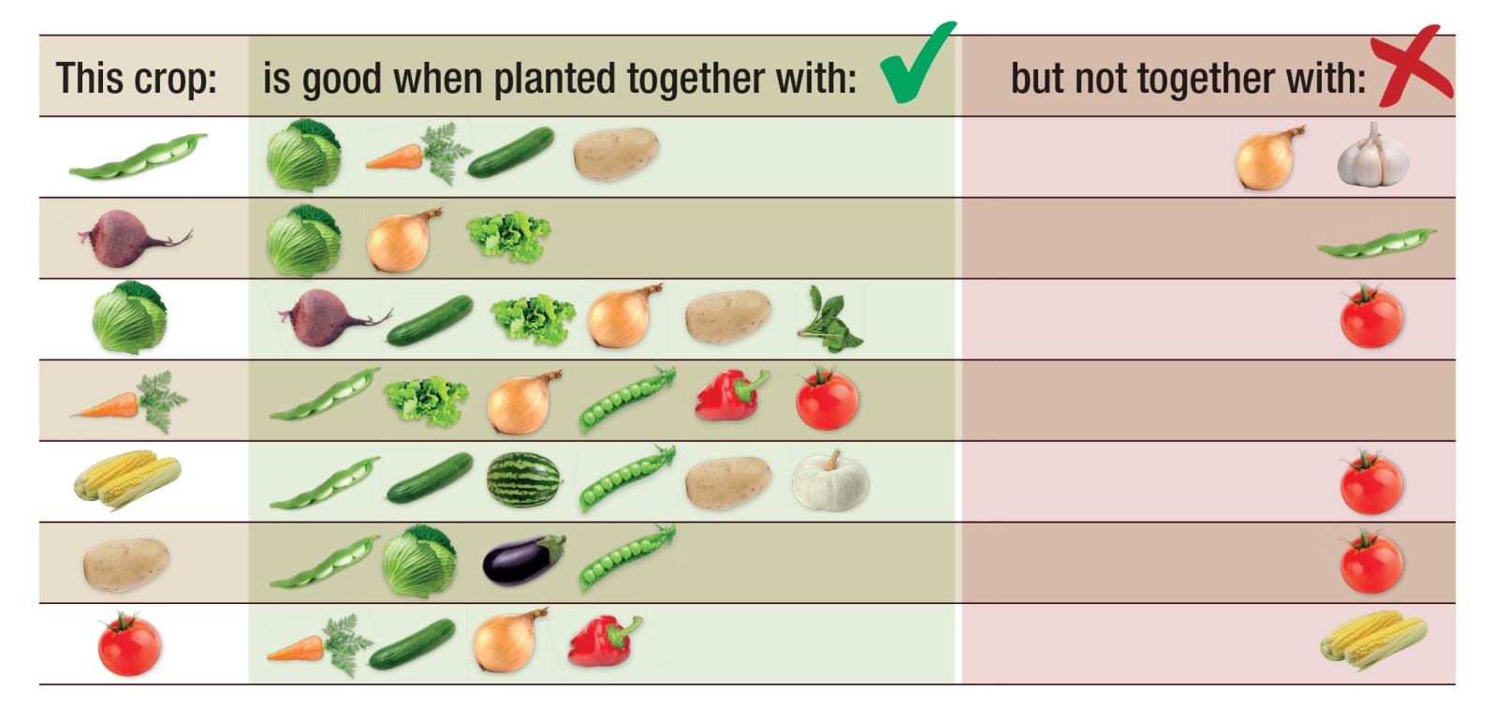
1. d. Companion planting for intercropping
Good pairing: produces higher yields and plants have a better resistance against pests and diseases.
Bad pairing: plants are less vigorous, produce fewer vegetables and are more prone to pests and diseases.
Notes:
When planted together certain plants will produce higher yields and are better able to defend themselves against disease and insects. On the other hand, planting certain types of incompatible plants together interferes with their growth. When grown together, these incompatible plants tend to be less vigorous, produce fewer vegetables and are more prone to diseases and pests. Examples of good and bad pairings:

Slide 8
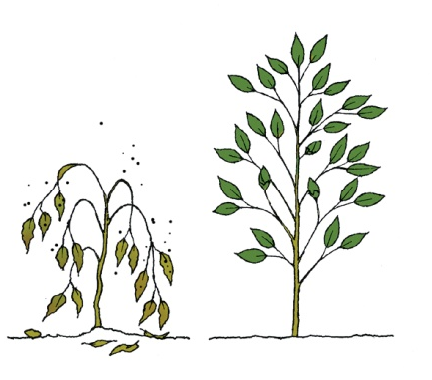
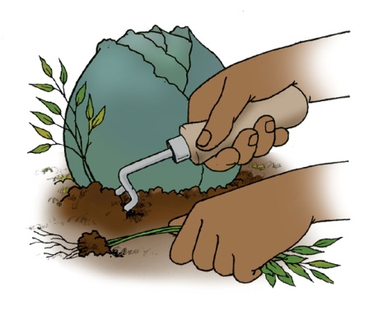
2. Organic pest control
Chemicals can be:
Expensive
Risky to human/animal life
Harmful to the environment if misused
Organic pest/disease control requires:
Good management
Watching out for pests/diseases at an early stage
Tips for organic pest control:
1. Irrigate and add fertilizer to keep plants strong and healthy
2. Weed and cultivate area around plant to improve drainage and destroy pests larvae
Notes:
Although pests and diseases can be controlled by using chemicals, these are expensive and risky to human and animal life and can harm the environment if misused. Organic pest and disease control can be used effectively but they need good management and watching out for pest and diseases at an early stage.
Keep plants strong and healthy by regular fertilization and irrigation. Pests and diseases easily attack weak and unhealthy plants.
Regularly weed and cultivate area around plants to improve drainage and destroy any damaging pest larvae that live in soil. Intercropping can also reduce the number of weeds (see section B - Intercropping and C - Succession planting left on this poster).

Slide 9
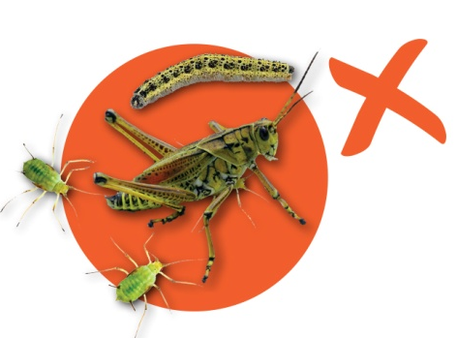
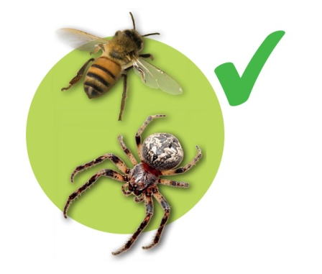
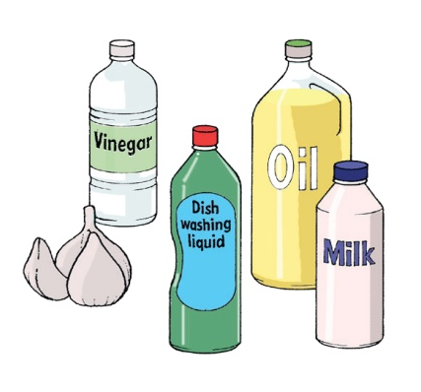
2. Organic pest control
3. Regularly inspect and remove eggs and larvae of insects from plants
4. Encourage the increase of helpful insects (ladybirds, lacewings, spiders, bees)
5. You can prepare home-made organic insecticides (see leaflet)
Notes:
Be vigilant. Inspecting the garden regularly and removing eggs and larvae of insects from your plants disrupts the life cycle of pests and prevents build-up of insect populations.
Encourage the increase of helpful insects (ladybirds, lacewings, spiders, bees).
Home-made organic insecticides: Information on how to make your own organic insecticides with products available at home (milk, dishwashing liquid and cooking oil) is available in the Home Gardening leaflet complementing this poster.

Slide 10
3. Compost making
What is “Compost”?
It is decomposed rotten material from plant, farm and household waste through the action of soil microbes.
Why making “Compost”?
It improves soil fertility and soil water holding capacity.
It reduces production costs.
It increases yields in quantity and quality.
You can apply compost together with animal waste (manure)
Notes:
Compost is decomposed rotten material from plant, farm and household waste through the action of soil microbes. It can be applied either alone or together with animal waste (manure).
Compost improves soil fertility and soil water holding capacity. It also reduces production costs and increases yields in quantity and quality.
Do NOT use plants that are attacked by pest and diseases or weeds with seeds, they will infect your new plants; burn them and use the ash instead.

Slide 11
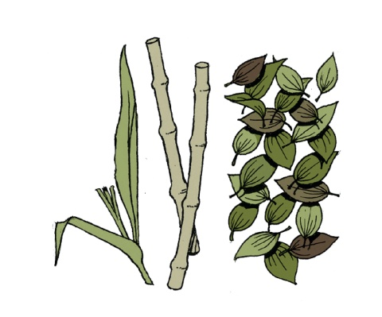
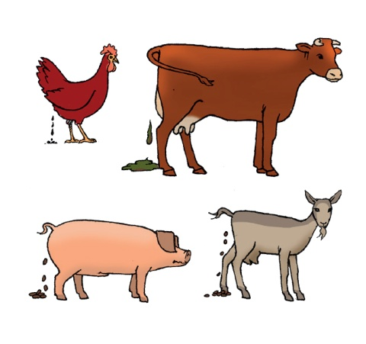
3. a. Materials needed
To make your own compost, you need:
Cereal stalks and leaves (maize, sorghum and wheat).
Legumes (beans, lentils) and other waste plant material
Manure: cattle, chicken, sheep, goat and pig dung.
Ashes from wood or crop residues.
Notes:
Materials needed:
Cereal stalks and leaves (maize, sorghum and wheat). Legumes (beans, lentils) and other waste plant material.
Manure: cattle, chicken, sheep, goat and pig dung. Ashes from wood or crop residues.

Slide 12
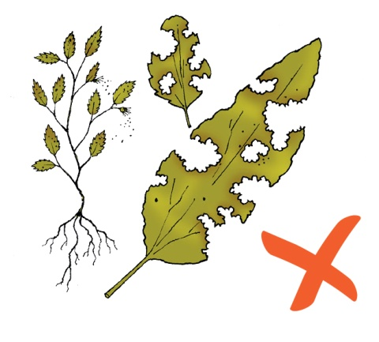
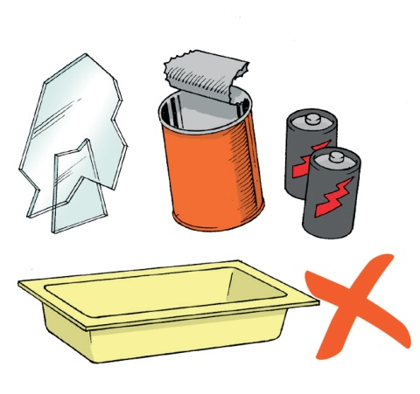
3. a. Materials needed
!
Do NOT use plants that are attacked by pests/diseases or weeds with seeds: they will infect your new plants.
!
Do NOT use glass, plastic, metal, old batteries and any material that will not break down in soil.
Notes:
Do NOT use plants that are attacked by pest and diseases or weeds with seeds, they will infect your new plants; burn them and use the ash instead.
Do NOT use glass, plastic, metal, old batteries and any material that will not break down in soil.

Slide 13
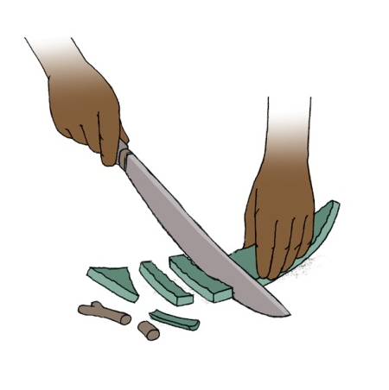
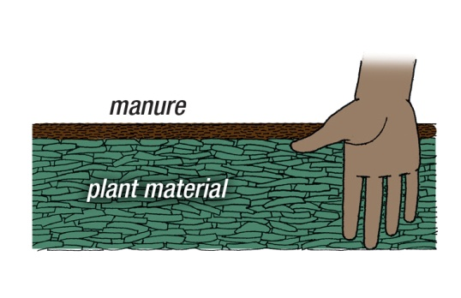
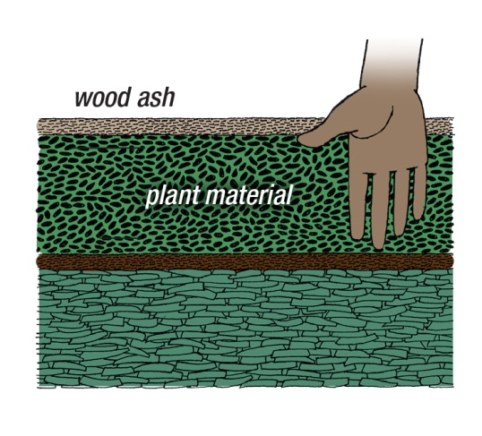
3. b. How to make compost
1. Chop large green or dry waste into smaller bits
2. Make a 15cm layer of this plant material; add a 2cm layer of animal manure on top of this.
3. Add a 15cm layer of plant material; add a 2cm layer of wood ash.
Repeat these steps until heap is 1m to 1.5m high.
Notes:
Roughly chop large green or dry waste into smaller bits (not too small as it should allow some air flow through it for composting).
Make a 15cm layer of this plant material then add a 2cm layer of animal manure on top of this.
Add a 15cm layer of plant material and add a 2cm layer of wood ash. Repeat the steps above until heap is 1m to 1.5m high.

Slide 14
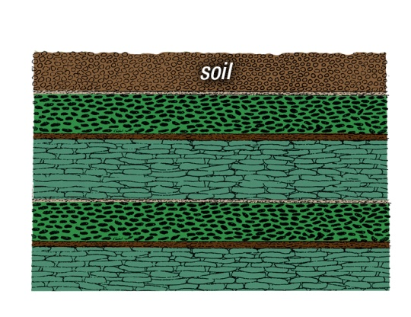
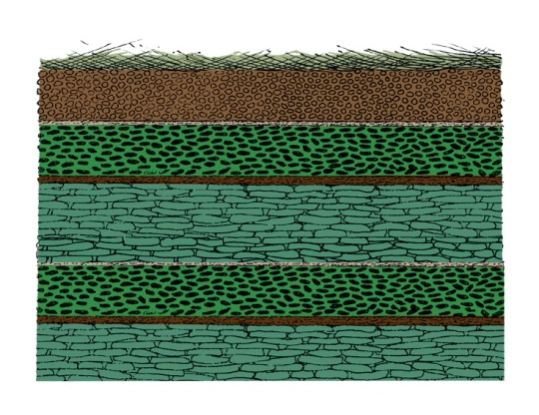
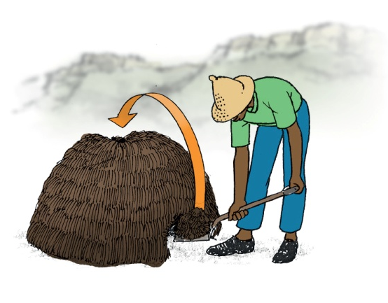
3. b. How to make compost
4. Cover with layer of soil to prevent loss of nutrients. Add water to dampen if the material is dry.
5. Cover soil with long grass or cloth sacks to keep it humid.
!
Do NOT cover with plastic bags.
6. Turn heap after 1 month. Move top and sides of heap into the middle. Sprinkle with water if dry and turn every 2 weeks until material is a rich, dark grey or brown colour.
Notes:
4. Cover with layer of soil to prevent loss of nutrients. Add water to dampen if the material is dry.
5. Cover soil with long grass or cloth sacks to keep it humid.
Do NOT cover with plastic bags as they prevent air flow through it. Compost making requires air flow through the materials.
6. Turn heap after 1 month. Move top and sides of heap into the middle. Sprinkle with water if dry and turn every 2 weeks thereafter until material is a rich, dark grey or brown colour.

Slide 15
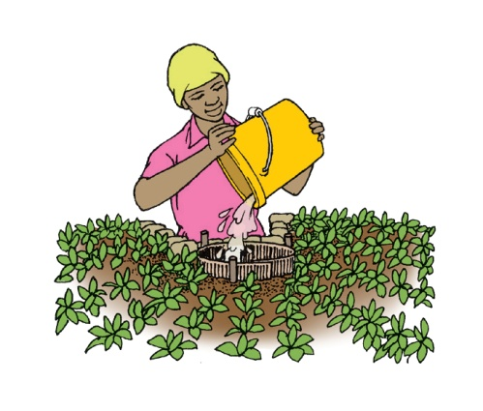
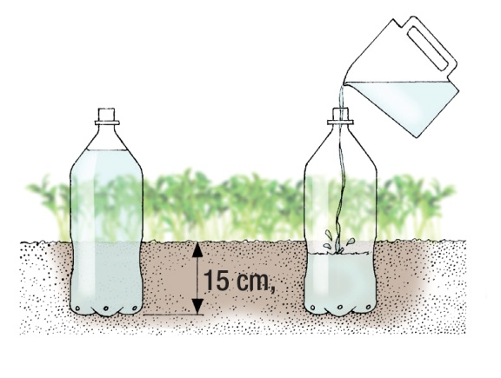
4. Watering
For keyhole garden
You can use “grey water” – water which was used for other household purposes (e.g. rinsing dishes/clothes).
!
Pour grey water through the basket
For drip irrigation
You can use cans/plastic bottles.
Make about four tiny holes at bottom of used empty containers; partially bury the empty container into ground next to plant roots. Fill the containers with water once a week or as needed.
Notes:
For keyhole garden use water that was used for other household purposes –” grey water” eg. water that was used for rinsing dishes and clothes. Grey water needs to be poured through the basket and clean water can be used directly on the garden.
Use cans and plastic bottles to make drip irrigation. Make about four tiny holes at bottom of used empty containers; partially bury the empty container into ground, 5 to 15 cm, next to plant roots. Fill the containers with water once a week or as needed.

Slide 16
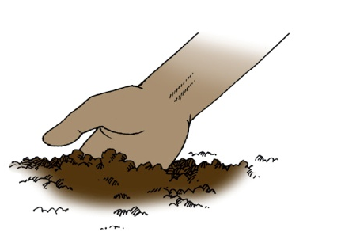
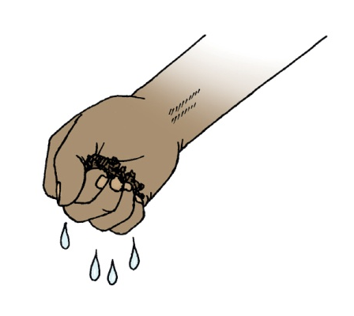
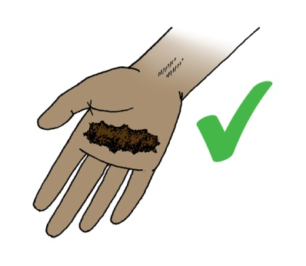
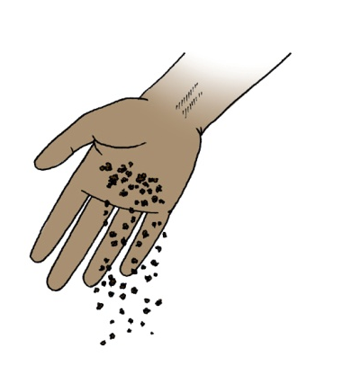
Do a simple soil moisture test:
1. Take a handful of soil from the garden and squeeze it tightly.
2. If water drips out through the fingers there may be too much water.
3. If soil remains compacted after opening your hand, there is no need for watering.
4. If soil falls apart after opening your hand, watering is required.
Notes:
Take a handful of soil from the garden and squeeze it tightly.
If water drips out through the fingers there may be too much water.
If soil remains compacted after opening your hand there is no need for watering.
If soil falls apart after opening your hand, watering is required

