Slide 1
Reverse Poster 2
Organic pest control remedies
Compost tea
Other pest control hints
Notes:
Some organic pest control mixtures can be made from different plant materials from your household.

Slide 2
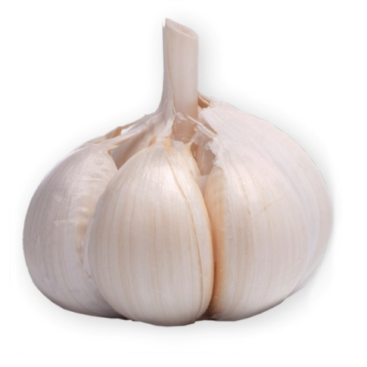
1. Organic pest control remedies
GARLIC SPRAY
Garlic spray is a general pest deterrent.
Ingredients
- 10 garlic heads
- 5 small hot chillies
- 3 medium onions
Directions
1) Mix all ingredients together, bring to the boil and simmer for 10 minutes.
2) Let it stand overnight then add 2 tablespoons of milk.
3) Store in labelled glass jars.
4) Use by diluting 1 cup of the mixture to 9 litres of water.
!
Do not apply this spray on a sunny day as the oils can cause foliage to burn.
Notes:
GARLIC SPRAY
Garlic spray is a general pest deterrent.
INGREDIENTS
10 garlic heads
5 small hot chillies
3 medium onions
DIRECTIONS
Mix all ingredients together, bring to the boil and simmer for 10 minutes.
Let it stand overnight then add 2 tablespoons of milk.
Store in labelled glass jars.
Use by diluting 1 cup of the mixture to 9 litres of water.
Don’t apply this spray on a sunny day, because the oils can cause foliage to burn.

Slide 3
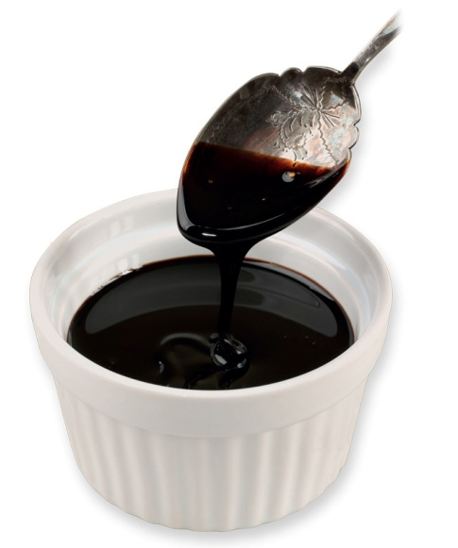
1. Organic pest control remedies
Molasses Spray
Molasses spray is a feeding deterrent for chewing insects (caterpillars, grasshoppers, cabbage moths and grubs) on the cabbage family.
Ingredients
- 1 tablespoon of molasses
- 1 litre of hot water
- 1 teaspoon of detergent
- Vinegar (optional)
Directions
1) Mix molasses with hot water until the colour of weak tea.
2) Mix in detergent to help the molasses stick to the leaves.
3) Spray undiluted to top and under side of the leaves.
4) Add vinegar to this brew to make it more potent.
Notes:
Molasses Spray
Molasses spray is a feeding deterrent for chewing insects (caterpillars, grasshoppers, cabbage moths and grubs) on the cabbage family.
INGREDIENTS
1 tablespoon of molasses
1 litre of hot water
1 teaspoon of detergent
Vinegar (optional)
DIRECTIONS
Mix molasses with hot water until the colour of weak tea.
Mix in detergent to help the molasses stick to the leaves.
Spray undiluted to top and under side of the leaves.
Add vinegar to this brew to make it more potent.
Molasses is the by-product of beating sugarcane, grapes or sugar beets into sugar.

Slide 4
1. Organic pest control remedies
CHAMOMILE TEA Spray
Chamomile tea is a mild fungicide.
Ingredients
- 1 chamomile tea bag
- Boiling water
Directions
1) Pour boiling water over a chamomile tea bag.
2) Leave to soak/steep for ten minutes.
3) Once cool, use as a spray.
This spray is also suitable to give sick plants a lift.
Notes:
CHAMOMILE TEA Spray
Chamomile tea is a mild fungicide.
INGREDIENTS
1 chamomile tea bag
Boiling water
DIRECTIONS
Pour boiling water over a chamomile tea bag.
Leave to soak/steep for ten minutes.
Once cool, use as a spray.
This spray is also suitable to give sick plants a lift.

Slide 5
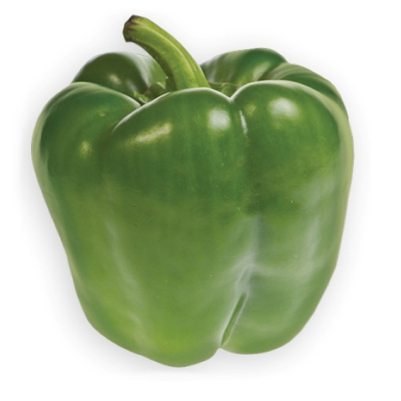
1. Organic pest control remedies
Pepper/Garlic Pesticide Spray
Pepper/Garlic pesticide is a general pesticide for
control of caterpillars, ants, mites and other insects.
Ingredients
- 3 hot green peppers (canned or fresh)
- 2 or 3 cloves garlic
- ¾ teaspoon of liquid soap
- 3 cups of water
Directions
1) Crush the garlic and pepper together.
2) Add the liquid soap and water. Let the mixture stand for 24hrs.
3) Strain out pulp and spray onto infested plants, making sure to coat both tops and bottoms of leaves.
Natural pest control is less expensive than buying pesticides, and it’s safer for your garden, your family, the natural wildlife and the environment.
Notes:
Pepper/Garlic Pesticide Spray
Pepper/Garlic pesticide is a general pesticide for control of caterpillars, ants, mites and other insects.
INGREDIENTS
3 hot green peppers (canned or fresh)
2 or 3 cloves garlic
3/4 teaspoon of liquid soap
3 cups of water
DIRECTIONS
Crush the garlic and pepper together.
Add the liquid soap and water. Let the mixture stand for 24 hours.
Strain out pulp and spray onto infested plants, making sure to coat both tops and bottoms of leaves.
Natural pest control is less expensive than buying pesticides, and it’s safer for your garden, your family, the natural wildlife and the environment.

Slide 6
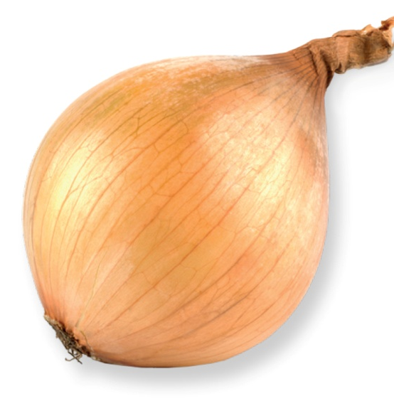
1. Organic pest control remedies
ONION SPRAY
Onion spray is used to control aphids, spiders and other pests.
Ingredients
- 2 cups of onion skins and peels (and/or garlic pieces)
- Warm water
Directions
1) Collect 2 cups of onion skins, peels and ends in a container. Garlic pieces can also be added.
2) Fill container with warm water. Soak for a few days/a week.
3) After one week, strain or sieve out the onion bits out and store the onion water in spray bottles. Spray undiluted on leaves.
Or you can bury the onion and garlic pieces around plants.
Begin treating for insects as soon as you notice signs of an infestation. The sooner you start the easier it will be to get rid of the insects.
Notes:
ONION SPRAY
Onion spray is used to control aphids, spiders and other pests.
INGREDIENTS
2 cups of onion skins and peels (and/or garlic pieces)
Warm water
DIRECTIONS
Collect 2 cups of onion skins, peels and ends in a container. Garlic pieces can also be added.
Fill container with warm water. Soak for a few days (up to a week).
After one week, strain or sieve out the onion bits out and store the onion water in spray bottles.
Spray undiluted on leaves.
Or you can bury the onion and garlic pieces around plants.
Begin treating for insects as soon as you notice signs of an infestation. The sooner you start the easier it will be to get rid of the insects.

Slide 7
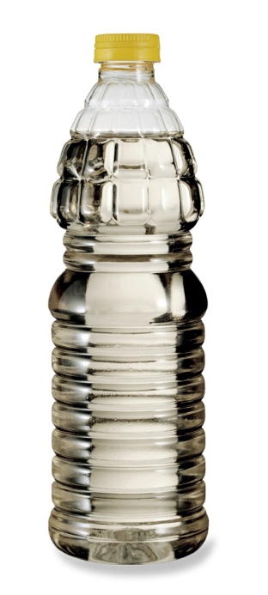
1. Organic pest control remedies
Vinegar Spray
Vinegar spray is for cabbage moths and grubs on the cabbage family, caterpillars and sap-sucking insects such as stink bugs, aphids and mealybugs.
Ingredients
- ¼ of vinegar to ¾ of water
- 1 teaspoon of detergent
Directions
1) Mix 1/4 of vinegar with 3/4 of water.
2) Mix in detergent to help the vinegar to stick to the insects and leaves of the plant.
3) Spray top and under side of the leaves.
Vinegar can be used undiluted or mixed into a spray.
Notes:
Vinegar Spray
Vinegar spray is for cabbage moths and grubs on the cabbage family, caterpillars and sap-sucking insects such as stink bugs, aphids and mealybugs.
INGREDIENTS
1/4 vinegar to 3/4 of water
1 teaspoon of detergent
DIRECTIONS
Mix 1/4 of vinegar with 3/4 of water.
Mix in detergent to help the vinegar to stick to the insects and leaves of the plant.
Spray top and under side of the leaves.
Vinegar can be used undiluted or mixed into a spray.

Slide 8
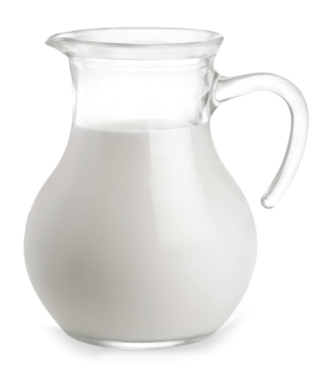
1. Organic pest control remedies
MILK Spray
Milk spray is an anti-fungal spray used for example on Powdery Mildew.
Ingredients
- Equal parts full cream milk and water
Directions
1) Mix equal parts full cream milk and water.
2) Spray plants every 2 days to control fungal diseases on peas, green peppers and pumpkin family.
Clear garden area of debris and weeds which are breeding places for insects.
Notes:
MILK Spray
Milk spray is an anti-fungal spray used for example on Powdery Mildew.
INGREDIENTS
Equal parts full cream milk and water
DIRECTIONS
Mix equal parts full cream milk and water.
Spray plants every 2 days to control fungal diseases on peas, green peppers and pumpkin family.
Clear garden area of debris and weeds which are breeding places for insects.

Slide 9
1. Organic pest control remedies
VEGETABLE OIL SPRAY
Oil spray is for scaled and soft bodied insects such as mites, aphids, mealybugs (oil suffocates insects)
Ingredients
- 1 tablespoon of dishwashing detergent
1 cup of vegetable oil
water
Directions
1) Mix the dishwashing detergent with the vegetable oil.
2) Mix until it turns white and store in an air tight bottle.
3) Dilute 1 to 2½ teaspoons of the emulsion to 1 cup of water in a spray bottle. Spray on plants covering all leaf and stem surfaces.
Do this during mild weather because if it’s hot, it may burn the plants’ leaves.
Notes:
VEGETABLE OIL SPRAY
Oil spray is for scaled and soft bodied insects such as mites, aphids, mealybugs (oil suffocates insects)
INGREDIENTS
1 tablespoon of dishwashing detergent
1 cup of vegetable oil
DIRECTIONS
Mix 1 tablespoon of dishwashing detergent and 1 cup of vegetable oil.
Mix together until it turns white and store in an air tight bottle.
Dilute 1 to 2 ½ teaspoons of the emulsion to 1 cup of water in a spray bottle. Spray on plants covering all leaf and stem surfaces.
Do this during mild weather because if it’s hot, it may burn the plant’s leaves.

Slide 10
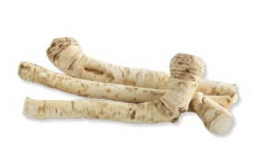
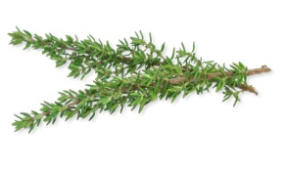
1. Organic pest control remedies
Other plants you can use for general pesticides
The following plants also contain anti-fungal or antibacterial chemicals that you can extract and spray onto crops:
Chamomile
Chives
Eucalyptus
Garlic
Horseradish
Marigolds
Parsnips
Turnips
Rhubarb
Thyme
!
Even though rhubarb stalks are very nutritious, rhubarb leaves can be toxic to humans.
Notes:
There are other plants you can use for general pesticides
The following plants also contain anti-fungal or antibacterial chemicals that you can extract and spray onto crops: chamomile, chives, eucalyptus, garlic, horseradish, marigolds, parsnips, turnips, rhubarb or thyme.
Please note: even though rhubarb stalks are very nutritious, rhubarb leaves can be toxic to humans.

Slide 11
2. Compost tea
What is “Compost tea”?
It is manure or compost dissolved in water.
Nutrients and micro-organisms from the compost and/or manure remain in the water which can be used to irrigate the garden as a complement to applying manure and/or compost.
How to make compost tea?
1. Fill a large cloth bag with 1 part of compost or manure (manure from plant-eating animals).
2. Tie the bag containing manure/compost to the centre of a thick stick.
Notes:
How to make compost tea
Fill a large cloth bag with 1 part of compost or manure (manure from plant-eating animals).
Tie the bag containing manure or compost to the centre of a thick stick.

Slide 12
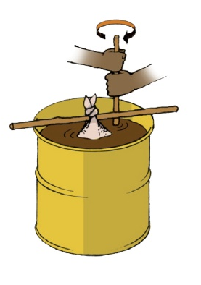
2. Compost tea
3. Fill a container with 3 to 10 parts of clean water and hang the bag across it by the stick so that the bag is completely covered in water.
4. Stir occasionally for 1 to 3 weeks, until the water is a deep brown colour.
5. Dilute the tea with water; 1 part of tea to 4 parts of water for soil application and 1 part of tea to 3 parts of water for direct application on plant leaves.
6. To prevent diseases, it is recommended that you use only cow, sheep and goat manure when making compost tea.
Notes:
Fill a container with 3 to 10 parts of clean water and hang the bag across it by the stick so that the bag is completely covered in water.
Stir occasionally for 1 to 3 weeks, until the water is a deep brown colour.
Dilute the tea with water; 1 part of tea to 4 parts of water for soil application and 1 part of tea to 3 parts of water for direct application on plant leaves.
It is recommended that you use only cow, sheep and goat manure when making compost tea to prevent diseases.

Slide 13
2. Compost tea
Apply compost tea directly to the leaves to give plants a quick shot of nutrients.
- Compost tea works best when applied in the morning and evening under cool, moist conditions.
- Apart from compost tea, manure and compost should still be applied to improve soil fertility.
Notes:
Apply compost tea directly to the leaves to give plants a quick shot of nutrients
Compost tea works best when applied in the morning and evening under cool, moist conditions.
Apart from compost tea, manure and compost should still be applied to improve soil fertility.

Slide 14
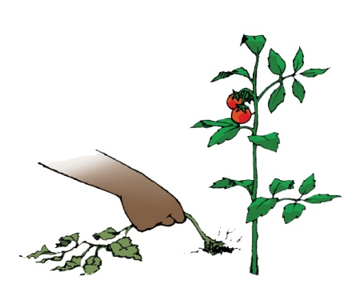
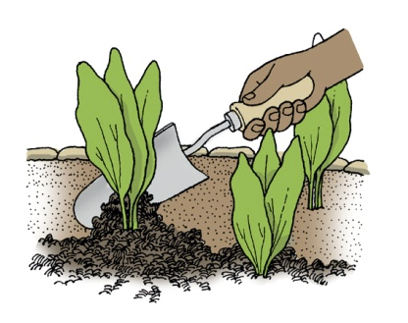
3. Other pest control hints
3. a. Prevention
Pull out weak, infected plants and destroy them away from your garden.
Build healthy soil through the use of compost, manure and mulch.
Minimise insect habitats by clearing debris and weeding regularly.
Notes:
Prevention
Pull out weak, infected plants and destroy them away from your garden.
Build healthy soil through the use of compost, manure and mulch.
Minimise insect habitats by clearing debris and weeding regularly.

Slide 15
3. Other pest control hints
Interplant and rotate crops so that pests and diseases do not spread throughout the garden.
Water early so leaves remain dry most of the day.
This is helpful as wet leaves encourage insect activity and fungal damage to plants.
Notes:
Interplant and rotate crops so that pests and diseases do not spread throughout the garden.
Water early so leaves remain dry most of the day. This is helpful as wet leaves encourage insect activity and fungal damage to plants.

Slide 16
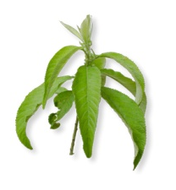
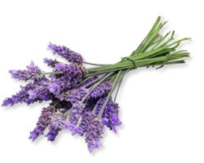
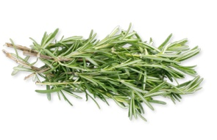
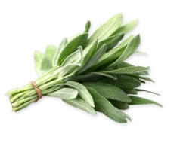
3. Other pest control hints
3. b. Use companion plants to mask smells
To mask the scent or appearance of crops that are desirable to pests, you can use herbs and highly aromatic plants such as:
Camphor
Mints
Lavender
Rosemary
Sage
…and other herbs that have spicy/bitter scents.
Notes:
Use companion plants to mask smells
Herbs and highly aromatic plants such as camphor, mints, lavender, rosemary, sage and other herbs that have spicy/bitter scents, can be used to mask the scent or appearance of crops that are desirable to pests.

Slide 17
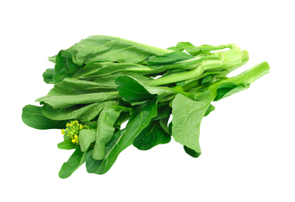
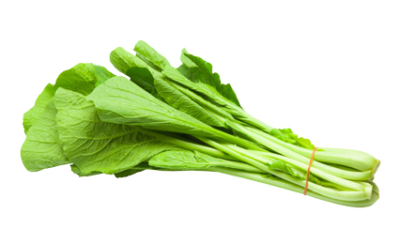
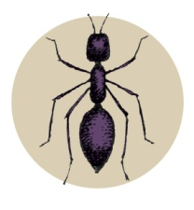
3. Other pest control hints
3. c. Use companion plants to trap insects
You can use certain plants as trap crops and decoys to insects, such as:
Mustard
Chinese cabbage
3. d. Control ants
- Control ants to reduce aphid and scale infestations on trees.
- Use a band of grease to stop ants climbing the trunk.
Notes:
Use companion plants to trap insects
Plants such as Mustard and Chinese cabbage can act as trap crops and decoys to insects.
Control ants
Control ants to reduce aphid and scale infestations on trees.
Use a band of grease to stop ants climbing the trunk.

