Slide 1
Reverse Poster 4
Cooking nutritiously and safely
Food preservation
Maternal and child feeding

Slide 2
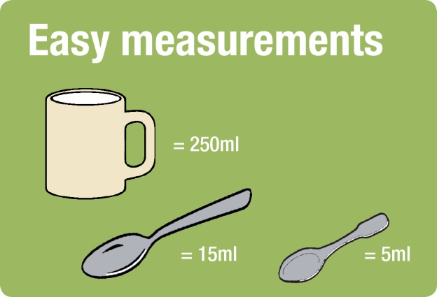
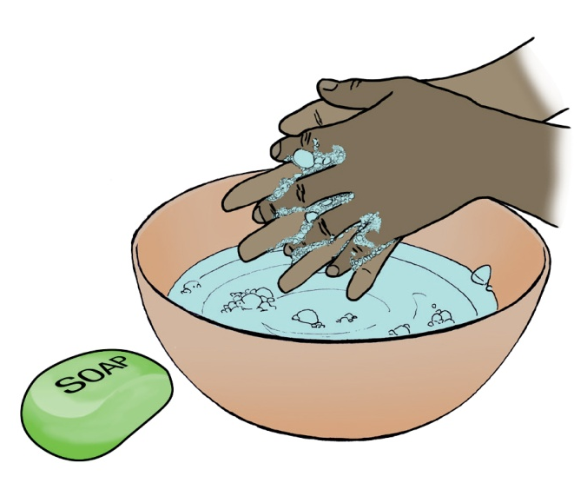
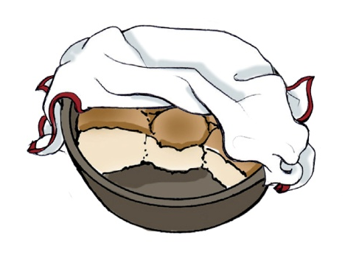
1. Cooking nutritiously and safely
BE SAFE AND
WASH YOUR HANDS!
It is very important to wash your hands before cooking, eating or feeding a child!
Keep your food clean and safe by covering it with a cloth.
Notes:
The way we cook and combine our food determines the nutritional benefits we can obtain from it. Safe water and clean hands while cooking and eating will keep us healthy. Recipes for nutritious dishes can be found here.
Be safe and wash your hands!
It is very important to wash your hands before cooking, eating or feeding a child!
Keep your food clean and safe by covering it with a cloth.

Slide 3
1. Cooking nutritiously and safely
Nutritious Sesotho Recipes
LIKAHARE (Cow, goat or mutton offal)
Ingredients
- Water as required (4 cups approximately)
- Animal tripe, intestines, kidney, heart, lung and liver
- 2 teaspoons of iodated salt
- 1 medium onion (optional)
- 3 medium tomatoes (optional)
- 1 green pepper (optional)
Method
1) Clean the offal and wash with plenty water. Cut all offal into
small pieces, put in a large pot and cover offal with cold water.
2) Boil for a few min. Lower the heat; simmer gently until cooked.
3) Season with salt and serve hot.
Alternatively. Set aside cooked offal and fry chopped onion. Add
chopped pepper and tomatoes; simmer for 10min. Add the offal
Liquid; cook for 5 min. Add cooked offal; simmer for 5min.
Notes:
LIKAHARE
Cow, goat or mutton offal
INGREDIENTS
Water as required (4 cups approximately)
Animal tripe, intestines, kidney, heart, lung and liver
2 teaspoons of iodated salt
1 medium onion (optional)
3 medium tomatoes (optional)
1 green pepper (optional)
METHOD
1) Clean the offal immediately after slaughtering and wash with plenty water. Cut all offal into small pieces and put in a large pot and cover offal with cold water.
2) Boil for a few minutes, then lower the heat and simmer gently until cooked.
3) Season with salt and serve hot.
4) Alternatively, set aside cooked offal and fry chopped onion in the pot. Add chopped pepper and tomatoes and simmer for 10 minutes. Add the offal liquid and cook for 5 minutes. Add cooked offal and simmer for about 5 minutes. Serve with papa and vegetables.

Slide 4
1. Cooking nutritiously and safely
NYEKOE (Sorghum with dry beans and pumpkin)
Ingredients
- Water as required (4 cups approximately)
- ½ cup of beans
- ½ cup of sorghum
½ cup of pumpkin
- 1 tablespoon of oil/margarine
- 1 teaspoon of iodated salt
Method
1) Soak beans and sorghum in water separately overnight
2) Sift beans and sorghum and cook them in clean water until almost cooked.
3) Cut pumpkin in pieces and add to beans and sorghum mixture until pumpkin, beans and sorghum are soft.
4) Add salt and oil. Simmer for 5-10 additional minutes stirring occasionally.
5) You can serve with green vegetables.
Notes:
NYEKOE
Sorghum with dry beans and pumpkin
INGREDIENTS
Water as required (4 cups approximately)
½ cup of beans
1/2 cup of sorghum
1/2 cup of pumpkin
1 tablespoon of oil/margarine
1 teaspoon of iodated salt
METHOD
1) Soak beans and sorghum in water separately overnight
2) Sift beans and sorghum and cook them in clean water until almost cooked.
3) Cut pumpkin in pieces and add to beans and sorghum mixture until pumpkin, beans and sorghum are soft.
4) Add salt and oil. Simmer for 5-10 additional minutes stirring occasionally.
5) You can serve with green vegetables.

Slide 5
1. Cooking nutritiously and safely
PAPA LE MOROHO (Hard porridge with vegetables)
PAPA
Ingredients
- 5 cups of cereal flour of your choice (maize, sorghum, wheat)
- Water (sufficient quantity to make thick porridge, approximately 7 cups)
Method
1) Bring water to a boil. Add the flour, stir and mix thoroughly.
2) Cover and allow cooking further over low heat for approximately 15 minutes stirring occasionally.
3) Serve with vegetables (moroho) and/or Likahare
Notes:
PAPA LE MOROHO (Hard porridge with vegetables)
PAPA
INGREDIENTS
5 cups of cereal flour of your choice (maize, sorghum, wheat)
Water (sufficient quantity to make thick porridge, approximately 7 cups)
METHOD
Bring water to a boil. Add the flour, stir and mix thoroughly.
Cover and allow cooking further over low heat for approximately 15 minutes stirring occasionally.
Serve with vegetables (moroho) and/or Likahare

Slide 6
1. Cooking nutritiously and safely
PAPA LE MOROHO (Hard porridge with vegetables)
MOROHO
Ingredients
- 3^{1/2} cups of vegetables of your preference (spinach, Florida Broad Leaf, rape, amaranthus, indigenous vegetables…)
- ½ cup of water
- Pinch of salt
- 2 teaspoons of sunflower oil
Method
1) Clean the vegetables, chop them into big chunks.
2) Poor cooking oil into the pot. Add chopped vegetables and salt. 3) Cook over medium heat for 5-10 minutes.
4) Add salt and oil, simmer for 5 minutes.
5) Serve papa le moroho with beans or eggs or meat/Likahare.
Notes:
PAPA LE MOROHO (Hard porridge with vegetables)
MOROHO
INGREDIENTS
3^{1/2} cups of vegetables of your preference (spinach, Florida Broad Leaf, rape, amaranthus, indigenous vegetables…)
½ cup of water
Pinch of salt
2 teaspoons of sunflower oil
METHOD
Clean the vegetables, chop them into big chunks.
Poor cooking oil into the pot. Add chopped vegetables and salt. Cook over medium heat for 5-10 minutes.
Add salt and oil, simmer for 5 minutes
Serve papa le moroho with beans or eggs or meat/Likahare.

Slide 7
1. Cooking nutritiously and safely
MOCHAHLAMA (Mealie meal and wheat bread)
Ingredients
- 1½ cups of white maize flour
- 1 cup of brown wheat flour
- 1 teaspoon of granulated brown sugar
- 3 cups of water
- 1 teaspoon of dried yeast
- 1 teaspoon of iodated salt
Method
1) In a small bowl, mix yeast, sugar and lukewarm water. Stir to dissolve. Let the mixture stand for a few minutes and reserve.
2) In a mixing bowl, mix mealie meal and boiling water. Stir thoroughly. Leave the mixture to cool down.
3) Add the wheat flour to the mealie meal mixture, then add the yeast mixture and mix thoroughly. Keep the mixture in a warm place while it rises.
4) Make balls and steam in pot for 30 minutes or until cooked.
Notes:
MOCHAHLAMA
Mealie meal and wheat bread
INGREDIENTS
1½ cups of white maize flour
1 cup of brown wheat flour
1 teaspoon of granulated brown sugar
3 cups of water
1 teaspoon of dried yeast
1 teaspoon of iodated salt
METHOD
In a small bowl, mix yeast, sugar and lukewarm water. Stir to dissolve. Let the mixture stand for a few minutes and reserve.
In a mixing bowl, mix mealie meal and boiling water. Stir thoroughly. Leave the mixture to cool down.
Add the wheat flour to the mealie meal mixture, then add the yeast mixture and mix thoroughly. Keep the mixture in a warm place while it rises.
Make balls and steam in pot for 30 minutes or until cooked.

Slide 8
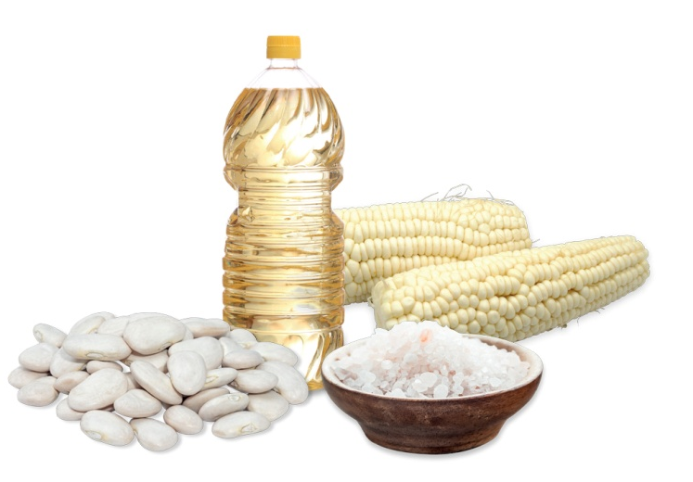
1. Cooking nutritiously and safely
SETAMPO LE LINAOA/UMNGQUSHO (Maize samp with dried beans)
Ingredients
- Water as required (4 cups approximately)
- 1¼ cups of maize samp
- 1¼ cups of beans (white beans or sugar beans or pinto beans)
- 1 tablespoon of sunflower oil
- 1 teaspoon of iodated salt
Method
1) Soak beans overnight.
2) Sieve beans and cook them with the samp in clean boiling water for 1 hour or until soft (adding water if necessary).
3) Add sunflower oil and salt; let simmer for further 10-15 minutes.
4) You can serve with vegetables.
Notes:
SETAMPO LE LINAOA/UMNGQUSHO
Maize samp with dried beans
INGREDIENTS
Water as required (4 cups approximately)
1¼ cups of maize samp
1¼ cups of beans (white beans or sugar beans or pinto beans)
1 tablespoon of sunflower oil
1 teaspoon of iodated salt
METHOD
1) Soak beans overnight.
2) Sieve beans and cook them with the samp in clean boiling water for 1 hour or until soft (adding water if necessary).
3) Add sunflower oil and salt, let simmer for further 10-15 minutes.
4) You can serve with vegetables.

Slide 9
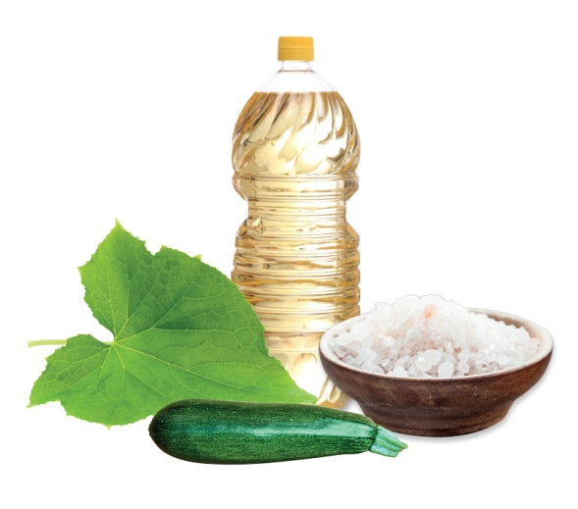
1. Cooking nutritiously and safely
LEPU (Pumpkin leaves with baby marrow)
Ingredients
- Water as required (1 cup approximately)
- 5½ cups of soft pumpkin leaves
- ½ cup of baby marrow (lebolotsana)
- 1 teaspoon of sunflower oil
- 1 teaspoon of iodated salt
Method
1) Clean the leaves and baby marrow. Chop the leaves and cube baby marrow.
2) Add water and cook over medium heat for 10 minutes.
3) Add salt and oil and simmer for another 5 minutes.
4) You can also season with half a teaspoon of curry powder.
Notes:
LEPU
Pumpkin leaves with baby marrow
INGREDIENTS
Water as required (1 cup approximately)
5½ cups of soft pumpkin leaves
½ cup of baby marrow (lebolotsana)
1 teaspoon of sunflower oil
1 teaspoon of iodated salt
METHOD
1) Clean the leaves and baby marrow. Chop the leaves and cube baby marrow.
2) Add water and cook over medium heat for 10 minutes.
3) Add salt and oil and simmer for another 5 minutes.
4) You can also season with half a teaspoon of curry powder.

Slide 10
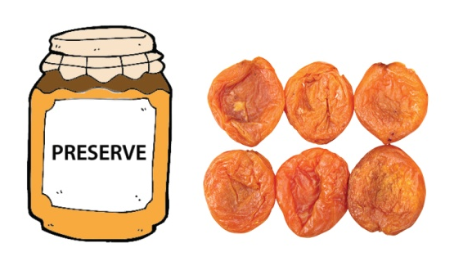
2. Food preservation
a. Drying Vegetables
Selection of vegetables for drying
Vegetables should be: - young, fresh, tender and clean,
- not be left long before being processed.
Vegetables such as green mealies and green peas should be blanched immediately after being picked before drying.
!
Use vegetables of the best quality only, since drying does not improve the quality of any product.
Blanching
Before drying, green mealies and some vegetables (e.g. peas, green beans, cabbage and carrots) should be blanched in steam. Young tender vegetables for 3 minutes and the rest for 5 minutes.
Steam blanching is recommended because it prevents the loss of some nutrients and improves preservation.
Notes:
Drying Vegetables
Selection of vegetables for drying
Use vegetables of the best quality only, since drying does not improve the quality of any product. The vegetables should be young, fresh, tender and clean, and should not be left long before being processed. Vegetables such as green mealies and green peas should be blanched immediately after being picked before drying.
Blanching
Before drying, green mealies and some vegetables (e.g. peas, green beans, cabbage and carrots) should be blanched in steam. Young tender vegetables for 3 minutes and the rest for 5 minutes. Steam blanching is recommended because it prevents the loss of some nutrients and improves preservation.

Slide 11
2. Food preservation
Dried vegetable preparation
Wash the vegetables thoroughly. Remove bruised or woody parts. Shell peas, shred cabbage, cut carrots into strips/slices 5mm thick.
Dried carrot:
Cut it into 2-3cm thick round slices or strips. Steam blanch for 5min, then submerge in cold water to prevent excessive cooking and then dry.
Dried tomato:
Cut mini tomatoes in half. Slice regular tomatoes into 1cm thick pieces; remove the seeds; then wipe with a sanitised cloth or paper towel. Lightly sprinkle with salt and dry.
Dried cabbage:
Wash cabbage and remove excess water. Shred into 2-4cm pieces. Steam blanch until it feels soft. Dry in the sun.
Notes:
Dried vegetable preparation
Wash the vegetables thoroughly. Remove bruised or woody parts. Shell peas, shred cabbage, cut carrots into strips or in slices 5 mm thick.
Dried carrot:
Cut it into 2 or 3cm thick round slices or strips. Steam blanch for 5 minutes, then submerge in cold water to prevent excessive cooking and then dry.
Dried tomato:
Cut mini tomatoes in half. Slice regular tomatoes into 1cm thick pieces, remove the seeds, and then wipe with a sanitised cloth or paper towel. Lightly sprinkle with salt and dry.
Dried cabbage:
Wash cabbage and remove excess water. Shred into 2-4cm pieces. Steam blanch until it feels soft. Then dry in the sun.

Slide 12
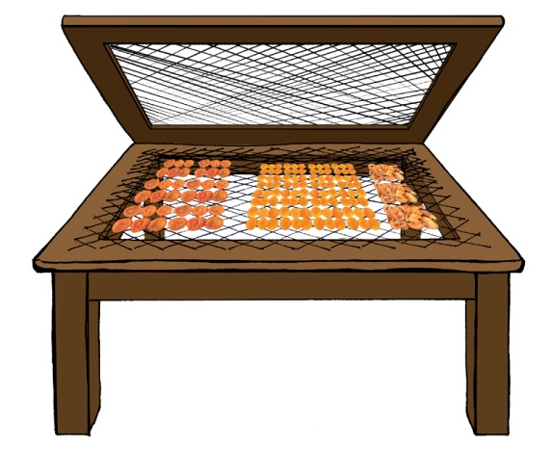
2. Food preservation
b. Drying Fruits
Selection of fruits for drying
Fruits should be ripe but not overripe; prepare them immediately.
Do not shake the fruits from the trees!
It will bruise them and bruised portions would turn black during the drying process.
!
Dried fruit preparation (e.g. peach, apricot, apple…)
1) Wash the fruits (peeled or unpeeled).
2) Cut in halves, quarters or smaller pieces.
3) Put them immediately to dry.
Notes:
DRYING FRUITS
Selection of fruits for drying
Pick ripe but not overripe fruit and prepare it immediately. Do not shake the fruits from the trees since this will bruise them and the bruised portions will turn black during the drying process.
Dried fruit preparation (e.g. peach, apricot, apple…)
Wash the fruit. It can be dried peeled or unpeeled. Cut in halves, quarters or smaller pieces. Then put them immediately to dry.

Slide 13
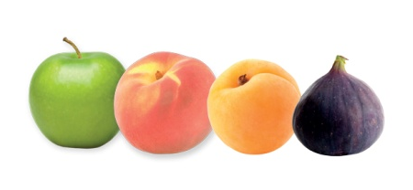
2. Food preservation
Dried apple
1) Wash the fruit (peeled or unpeeled)
2) Cut as explained above.
3) While peeling, immerse them in salty water with lemon juice added. Remove excess water with a dry cloth and then dry in sunlight until done.
Fruit leather
1) Use ripe fruits such as apples, apricots, quinces, pears, peaches or figs.
2) Wash, peel and remove the stones or cores.
3) Mince the fruit. Add a pinch of salt.
4) Spread the minced fruit 5mm thick on, for example, greased butter paper or a clean plastic sheet. Allow to dry on a board in the sun. Protect it from flies and dust.
Notes:
Dried apple:
Wash the fruit first. It can be dried peeled or unpeeled and be in halves, quarters or smaller pieces. While peeling, immerse them in salty water with lemon juice added. Remove excess water with a dry cloth and then dry in the sunlight until done.
Fruit leather
1) Use ripe fruits such as apples, apricots, quinces, pears, peaches or figs.
2) Wash, peel and remove the stones or cores.
3) Mince the fruit. Add a pinch of salt.
4) Spread the minced fruit 5 mm thick on, for example, greased butter paper or a clean plastic sheet. Allow to dry on a board in the sun. Protect it from flies and dust.

Slide 14
2. Food preservation
Instructions for bottling
1) In a separate pot, boil the washed bottles to be used for bottling the preserve.
2) Take bottles from boiling water and fill them immediately with the preserve mix.
3) Dip the jar lids in boiling water for a few seconds and then seal the bottles.

Slide 15
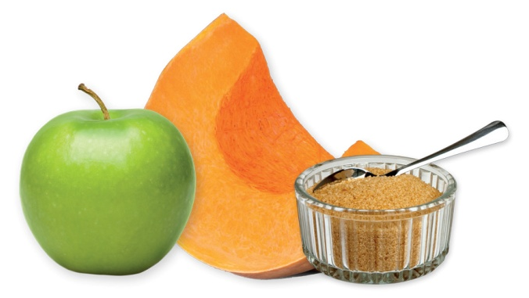
2. Food preservation
Jam making (Pumpkin & Apple jam)
Ingredients
- 6 apples finely chopped
- 7 cups of water
- 4 cups of pumpkin
- 3 cups of sugar
- 1 tablespoon of juice of 1 lemon
Method
1) Cook apples in water until tender. When cooked, save the water from which the apples were cooked. Sieve the apples.
2) Peel pumpkin and remove seeds. Chop into small pieces. Cook on medium heat using the water saved earlier; mash the pumpkin.
3) Combine pumpkin and apples into a pan.
4) Add lemon juice and sugar (¾ cup sugar for every cup of fruits).
5) Boil until done (thick consistency).
6) Remove from heat, stirring occasionally for a further 5 minutes.
7) Pour into hot, sterilised jars and seal.
Notes:
Jam making
PUMPKIN & APPLE JAM
INGREDIENTS
6 apples finely chopped
7 cups of water
4 cups of pumpkin
1 tablespoon of juice of 1 lemon
3 cups of sugar
METHOD
1) Cook apples in water until tender. When cooked, save the water from which the apples were cooked. Sieve the apples.
2) Peel pumpkin and remove seeds. Chop into small pieces. Cook on medium heat using the water saved from the apples.
Mash the pumpkin when cooked.
3) Combine pumpkin and apples into a pan (measure with a cup beforehand).
4) Add lemon juice and sugar (¾ cup sugar for every cup of fruit mixture).
5) Boil until done (thick consistency).
6) Remove from heat, stirring occasionally for a further 5 minutes.
7) Pour into hot, sterilised jars and seal.

Slide 16
2. Food preservation
Pickles, Preserves and Chutney (Fruit preserve)
Ingredients
Any of the following fruits: apples, peaches, apricots, Sugar
Method
1) Select firm ripe fruits. Peel, discard seeds and stem ends
and then slice into halves or quarters.
2) If using apples, plunge peeled apples into cold salt water or lemon juice water immediately to prevent discolouration.
3) Make the syrup as suggested on the syrup table (next slide).
4) In a pot, boil washed bottles to be used for bottling the preserve.
5) Boil the fruit pieces in the syrup for 5 minutes.
6) Take bottles from boiling water and fill them immediately with
the preserve mix.
7) Dip the jar lids in boiling water for a few seconds and then seal the bottles.
Notes:
Pickles, Preserves and Chutney
FRUIT PRESERVE
INGREDIENTS
Any of the following fruits: apples, peaches, apricots, Sugar
METHOD
Select firm ripe fruits. Peel, discard seeds and stem ends
and then slice into halves or quarters.
If using apples, plunge peeled apples into cold salt water or lemon juice water immediately to prevent discolouration.
Make the syrup as suggested on the syrup table on the right.
In a separate pot, boil the washed bottles to be used for bottling the preserve.
Boil the fruit pieces in the syrup for 5 minutes.
Take bottles from boiling water and fill them immediately with the preserve mix.
Dip the jar lids in boiling water for a few seconds and then seal the bottles.

Slide 17
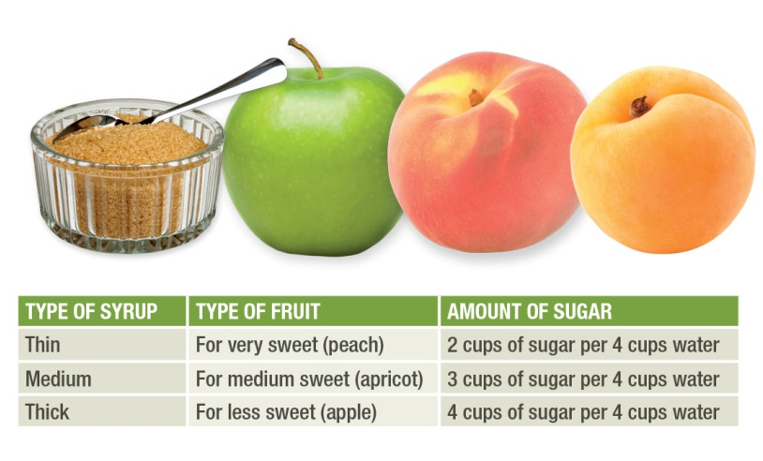
2. Food preservation
Indications for making a syrup

Slide 18
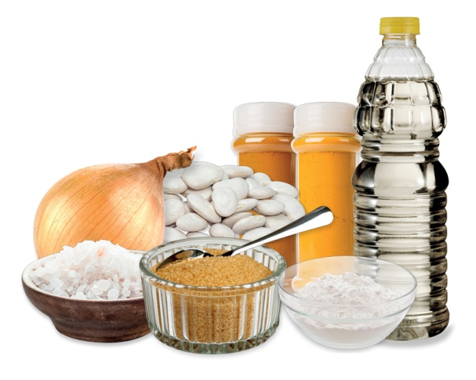
2. Food preservation
Curried bottled beans
Ingredients
- 6 cups of cooked brown or small white beans
- 3 cups of sliced onions
- 2 cups of sugar
- 2 tablespoons of sunflower oil
- 1 tablespoon of salt
- 6 tablespoons of curry powder
- 1 tablespoon of turmeric
- 1 teaspoon of corn flour
- 2 cups of brown vinegar
Method
1) Stir fry the onion in a pot with the oil.
2) Add the beans and cook for 10 minutes.
3) Mix the rest of dry ingredients, add the vinegar and mix well.
4) Add the vinegar mixture to the beans and simmer for 5 minutes.
5) Pour into hot sterilised jars and seal following the instructions for bottling.
Notes:
CURRIED BOTTLED BEANS
INGREDIENTS
6 cups of cooked brown or small white beans
3 cups of sliced onions
2 cups of sugar
2 tablespoons of sunflower oil
1 tablespoon of salt
6 tablespoons of curry powder
1 tablespoon of turmeric
1 teaspoon of corn flour
2 cups of brown vinegar
METHOD
1) Stir fry the onion in a pot with the oil.
2) Add the beans and cook for 10 minutes.
3) Mix the rest of dry ingredients, add the vinegar and mix well.
4) Add the vinegar mixture to the beans and simmer for 5 minutes.
5) Pour into hot sterilised jars and seal following the instructions for bottling.

Slide 19
3. Maternal and child feeding
Adequate nutrition before and during pregnancy, throughout breastfeeding and in early childhood is critical for the mother and the child.
1. Pregnant women
- Pregnant women should eat a nutritious snack during the day such as:
a glass of fresh/sour milk
eggs
a piece of fruit
nuts, seeds.
- Pregnant women should:
take iron
take folic acid
- attend ante-natal clinics monthly
2. Lactating women
Lactating women need more energy than during their pregnancies. They should:
- eat more at each meal OR
- have smaller frequent meals OR
- eat more nutritious healthy snacks between meals
- take vitamin A capsules (if ordered by the doctor)
Notes:
3. Maternal and child feeding
Adequate nutrition before and during pregnancy, throughout breastfeeding and in early childhood is critical for the mother and the child.
1. Pregnant women
Pregnant women need more energy than usual especially towards the end of the pregnancy. They should eat a nutritious snack during the day like a glass of fresh or sour milk, eggs, a piece of fruit, nuts and seeds.
Pregnant women should take iron and folic acid tablets as their bodies need more of these during pregnancy, and they should attend ante-natal clinics monthly.
2. Lactating women
Lactating women need more energy than during their pregnancies. They should eat more at each meal or have smaller frequent meals or eat more nutritious healthy snacks between meals. If given vitamin A capsules by the doctor, they should take them to protect themselves and their children.

Slide 20
3. Maternal and child feeding
3. Feeding babies aged 0-6 months
- Breastfeeding should be done when baby demands.
- After 6 months, complementary foods (soft and blended foods) should be introduced while breastfeeding continues until the child is 2 years old.
4. Feeding children over 6 months
- After 6 months, breast milk is not enough but it is important for a child’s growth to continue until he/she is at least 2 years old (see advice for HIV positive mothers in next slide).
- Young children have small stomachs and can only eat small portions at a time in frequent meals.
- Young children should have 2-4 meals a day plus 1-2 healthy snacks in between.
- Healthy snacks for children are: fruits, carrots, boiled eggs, sour milk, bread, sweet potatoes, roasted nuts and seeds.
Notes:
3. Feeding babies aged 0-6 months
Breast feeding should be done when baby demands.
After 6 months, complementary foods (soft and blended foods) should be introduced while breastfeeding continues until the child is 2 years old.
4. Feeding children over 6 months
After 6 months, breast milk is not enough: the baby needs other foods. But it is important for a child’s growth to continue until he/she is at least 2 years old (see above advice for HIV positive mothers). Young children have small stomachs and can only eat small portions at a time in frequent meals.
Young children should have 2-4 meals a day plus 1-2 healthy snacks in between.
Healthy snacks for children are: fruits, carrots, boiled eggs, sour milk, bread, sweet potatoes, roasted nuts and seeds.

Slide 21
3. Maternal and child feeding
Feeding babies of HIV-infected mothers
HIV+ mothers taking antiretroviral therapy can exclusively breastfeed their babies until 6 months.
- While still on antiretroviral therapy, mothers should introduce complementary feeding when the baby is 6 months and continue to breastfeed their babies until 12 months.
- After 12 months of age, breastfeeding should only stop once a nutritionally adequate and safe diet without the breast milk can be provided to the infant.
HIV+ mothers should be informed by the medical services of options available to them according to their individual circumstances.
!
Notes:
Feeding babies of HIV-infected mothers
The Government of Lesotho recommends that HIV positive mothers receive antiretroviral therapy. Under antiretroviral therapy, mothers can exclusively breastfeed their babies until 6 months. However, mothers should be informed by the medical services of other options available to them according to their individual circumstances.
While still on antiretroviral therapy, mothers should introduce complementary feeding when the baby is 6 months and continue to breastfeed their babies until 12 months.
After 12 months of age, breastfeeding should only stop once a nutritionally adequate and safe diet without the breast milk can be provided to the infant. Appropriate complementary feeding should continue to be provided during this time.

