Slide 1
DIVERSIFY CROPS
3
Increasing the variety you get from your homestead garden
Home Gardening and Nutrition Training Material
Notes:
Planting different varieties of vegetables in the right periods of the year and taking due care of fruit trees will allow us to diversify the food our family consumes.

Slide 2
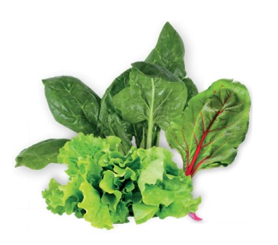
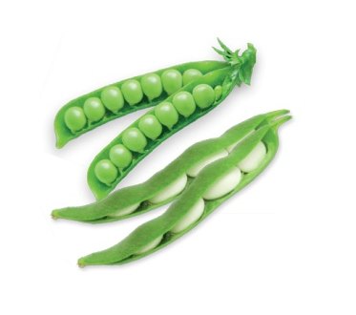
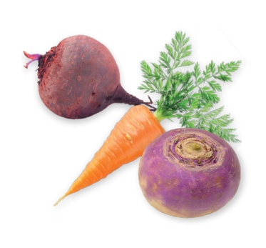
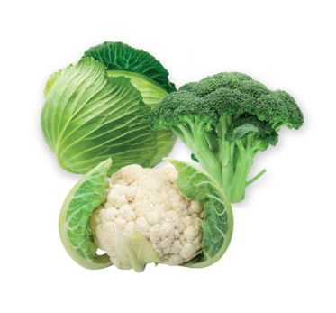
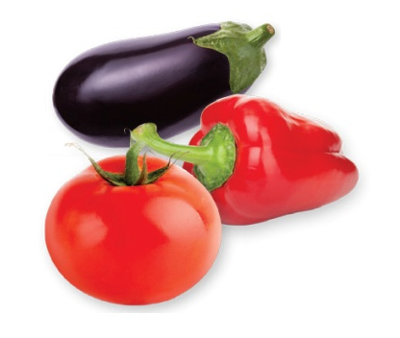
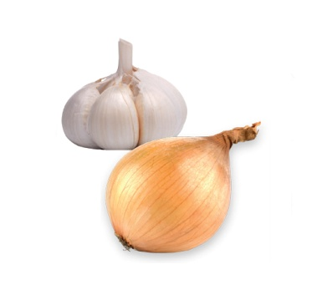
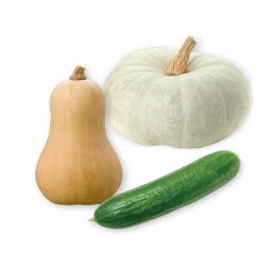
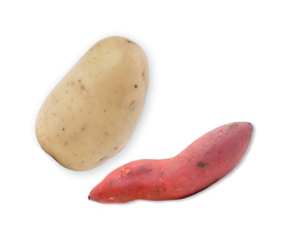
1. Different groups of vegetables
Leafy: spinach, lettuce, swiss chard, radish, rape, etc.
Legumes: beans, peas, etc.
Roots: carrot, beetroot, turnip, etc.
Brassicas: cabbage, cauliflower, broccoli, etc.
Solanacae: peppers, tomato, chilli, eggplant etc.
Bulbs: onion, garlic, etc.
Cucurbits: pumpkin, butternut, cucumber, etc.
Tubers: potato, sweet potato, etc.

Slide 3
2. Crop planting calendar
To achieve better yields, you need to know the optimum planting time for each kind of vegetable crop depending on Lesotho’s agro-ecological zone.
See figures below and in the following slide
Notes:
Different crops have different planting times in different areas of Lesotho. Part of achieving the best yields success in homestead gardening is knowing the best time to plant the various kinds of vegetable crops in Lesotho’s different climate areas.

Slide 4
2. Crop planting calendar

Slide 5
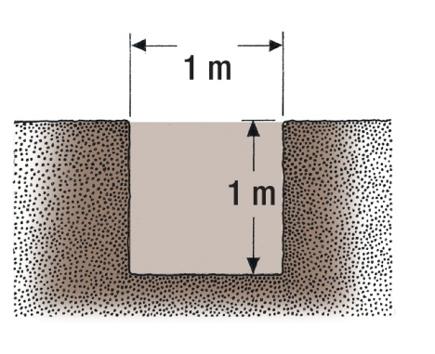
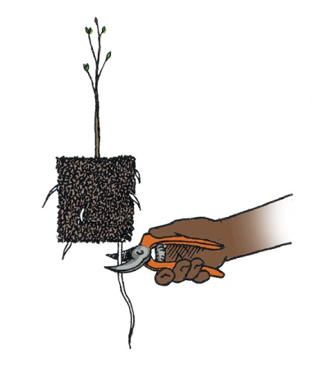
3. Fruit tree growing and care
Deciduous trees and vines can be planted any time during their dormant season.
Planting trees in summer is not recommended.
3. a. Planting fruit trees
Soil mix:
Mix top soil with sub soil and add well decomposed manure or compost.
1. Dig a hole that is 1m x 1m square and 1m deep. Prepare a soil mix.
2. Prune off roots that are dry, broken, discoloured or too long.
!
Do NOT put
fertiliser directly in hole as it may burn tender roots.
Notes:
Deciduous trees and vines can be planted any time during their dormant season (the time between leaf fall in autumn and swelling of buds in spring).
Planting trees in summer is not recommended as the heat puts stress on the new trees and they will need constant watering.
Dig a hole that is 1m x 1m square and 1m deep. Prepare a soil mix: mix top soil with sub soil and add well decomposed manure or compost. Do not put fertiliser directly in hole as it may burn tender roots.
Prune off roots that are dry, broken, discoloured or too long.

Slide 6
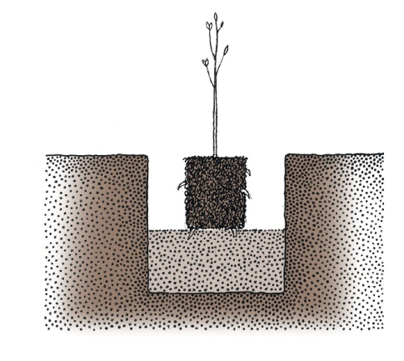
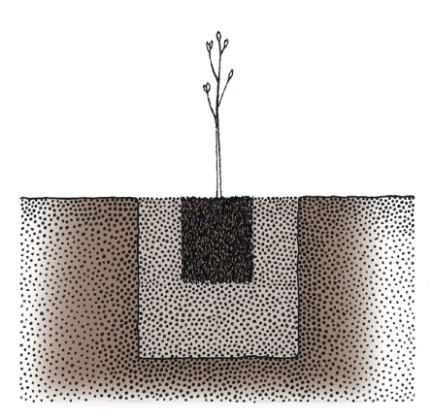
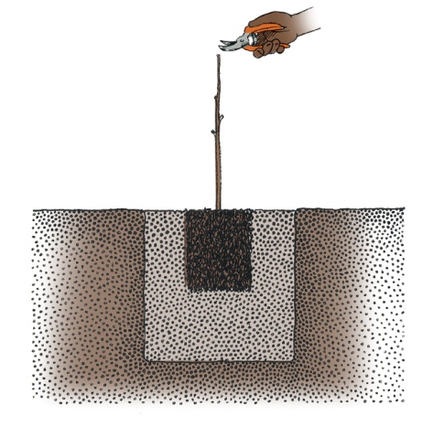
3. a. Planting fruit trees
3. Use the soil mix you prepared to
fill the bottom of the hole. Place the tree in the hole.
4. Fill the hole with the soil mix and firm the soil around the tree.
Add organic mulch on top of the soil-filled hole.
5. Cut the young tree to about 60cm.
Remove all the side branches.
Notes:
3. Place the tree in the hole to the same depth at which it grew in the nursery (use the soil mix you prepared to fill the bottom of the hole). The wound from grafting should be above soil level and face away from prevailing winds (to prevent tree breakage).
4. Fill the hole with the soil mix prepared earlier. Then firm the soil around the tree.
Add organic mulch on top of the soil-filled hole.
5. Cut the young tree to about 60cm (about the same height as 2 x 20 litre buckets). Remove all the side branches.

Slide 7
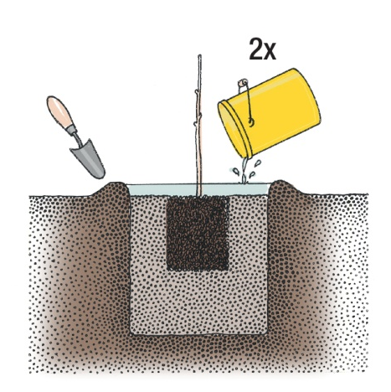
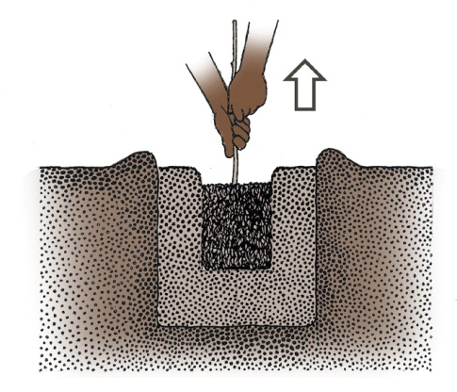
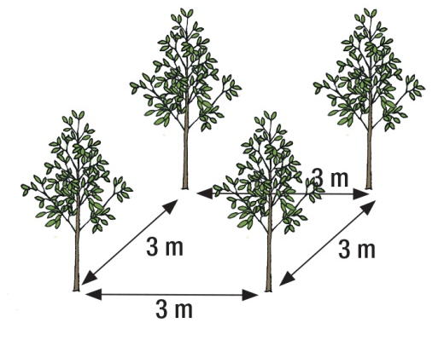
3. a. Planting fruit trees
6. Make a watering basin about 1m in diameter. Water tree with about 2 x 20 litre bucket.
7. Re-check planting depth. If trees have settled too deep, gently lift them by lower trunk until they are raised to proper height.
8. Spacing: fruit trees should be planted 3m apart to ensure enough nutrients and light for good fruit development.
Notes:
6. Make a watering basin about the same size as the planting hole (1m in diameter). Water tree with about 2 x 20 litre bucket.
7. Re-check planting depth. If trees have settled too deep, gently lift them by lower trunk until they are raised to proper height.
8. Spacing: fruit trees should be planted 3 m apart to ensure enough nutrients and light for good fruit development.

Slide 8
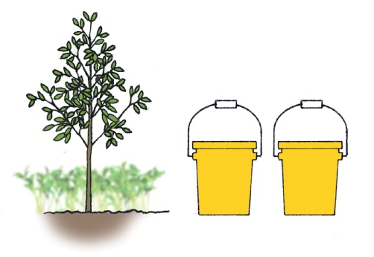
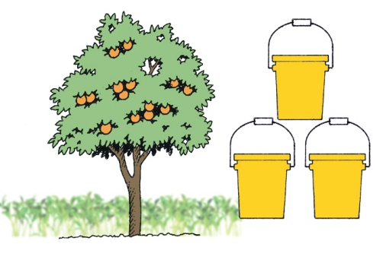
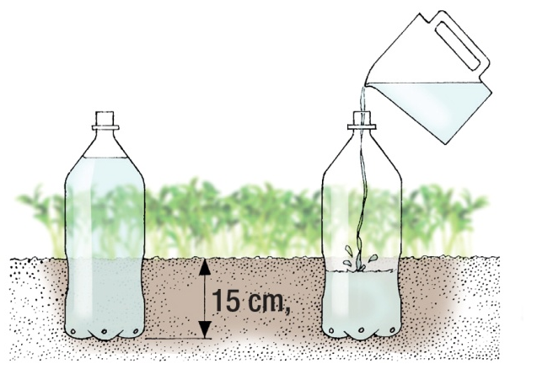
3. b. Watering and feeding fruit trees
Young trees: 2x20 L buckets of water every 2-3 weeks. You can add organic fertiliser throughout the growing season.
Fruit bearing trees: Add 3x20 L buckets every 2 weeks (especially during blossoming and fruit maturation). You can
add fertiliser only during spring and after fruit harvest.
Drip irrigation: make 4 tiny holes at bottom of empty containers; partially bury the empty container into ground next to tree roots. Fill the containers with water once a week or as needed.
Notes:
For young trees with small root system 2 x 20 litre buckets of water per tree every 2 to 3 weeks. Young trees can be fertilised throughout the growing season with organic fertilisers.
For fruit bearing trees (3 years+) water application especially needed during blossoming and fruit maturation. Add 3 x 20 litre buckets per tree every 2 weeks. Fruit bearing trees should only be fertilised during spring and after fruit harvest.
Or use drip irrigation: make 4 tiny holes at bottom of empty containers; partially bury the empty container into ground, 5 to 15 cm, next to tree roots. Fill the containers with water once a week or as needed.

Slide 9
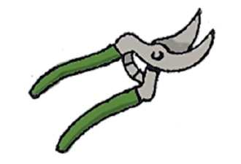
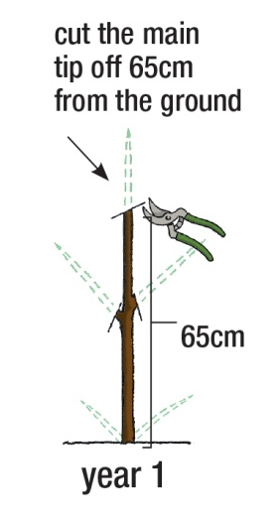
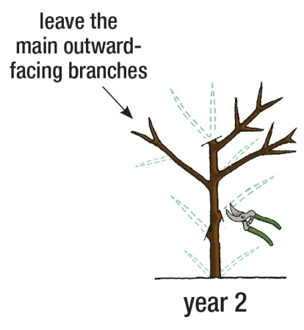
3. c. Pruning fruit trees
General fruit tree pruning instructions:
1. Prune in winter, when trees are dormant.
2. Prune out all branches originating from the base of the tree (suckers) or tender straight twigs originating inside the tree canopy (water sprouts).
Notes:
General fruit tree pruning instructions:
Prune in winter, when trees are dormant.
Prune out all branches originating from the base of the tree (suckers) or tender straight twigs originating inside the tree canopy (water sprouts).

Slide 10
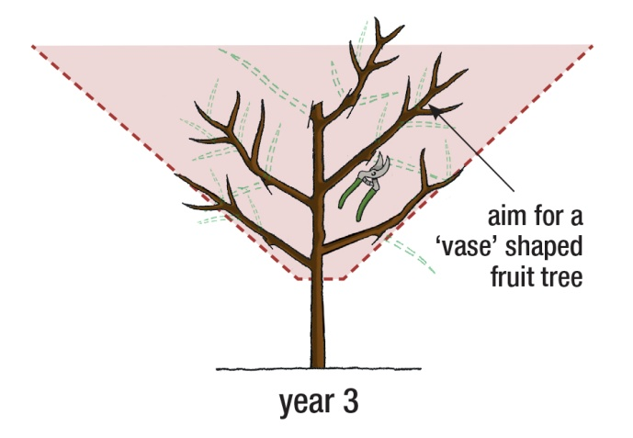
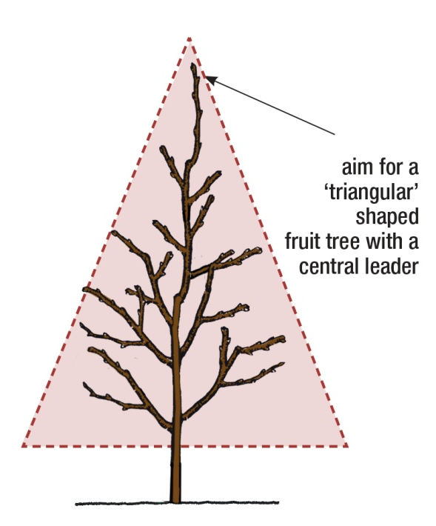
3. c. Pruning fruit trees
Methods of pruning stone fruit trees and pome fruit trees are different.
3. Stone fruit trees should form a vase shape allowing light and air circulation.
4. Pome fruit trees should maintain a central leader or triangular shape (taller
than stone fruit trees).
Notes:
Methods of pruning stone fruit trees and pome fruit trees are different.
3. Stone fruit tree should form a vase shape allowing light and air circulation.
4. Pome fruit trees should maintain a central leader or triangular shape (taller than stone fruit trees).
Pest and disease control
Information on pest and disease control affecting fruit trees and how to treat them is available on the handout with Poster 3.

