Slide 1
Reverse Poster 3
1. Pruning fruit trees
2. Thinning fruit trees
3. Effective fruit tree watering and feeding
4. Pest and disease control

Slide 2
1. Pruning fruit trees
Pruning is the selective removal of parts of plants to promote patterns of growth.
Why pruning ?
To control the shape and size of the tree
To improve light reaching all parts of the tree
To encourage and maintain abundant growth
To maintain health of tree by removing dead and diseased branches
To improve fruit growth
Notes:
Pruning is the selective removal of parts of plants to promote patterns of growth.
Reasons for pruning:
To control the shape and size of the tree
To improve light reaching all parts of the tree
To encourage and maintain abundant growth
To maintain health of tree by removing dead and diseased branches
To improve fruit growth
The pruning of branches on fruit trees creates a strong structure that can:
- With-stand wind without breaking
- Carry heavy crops of fruit
- Be harvested easily, as the tree is not too large.
Pruning also increases light and air circulation between the branches of the tree to reduce diseases and help fruit to form and ripen.

Slide 3
1. Pruning fruit trees
Why pruning ?
Pruning increases light and air circulation between the branches of the tree to reduce diseases and help fruit to form and ripen.
The pruning of branches on fruit trees creates a strong structure that can:
- With-stand wind without breaking
- Carry heavy crops of fruit
- Be harvested easily, as the tree is not too large.
Notes:
Reasons for pruning:
Pruning increases light and air circulation between the branches of the tree to reduce diseases and help fruit to form and ripen.
The pruning of branches on fruit trees creates a strong structure that can:
- With-stand wind without breaking
- Carry heavy crops of fruit
- Be harvested easily, as the tree is not too large.

Slide 4
1. Pruning fruit trees
When to prune?
- In winter when trees are dormant, to prevent damage from frost (from end July to end August).
- In summer only to remove damaged/diseased branches, water sprouts and suckers.
The desired height should be kept to enable easy management of the tree such as spraying and harvesting.
!
Always prune on dry days, to reduce the chance of getting diseases on the open wounds.
Notes:
Prune in winter when trees are dormant, to prevent damage from frost (from end July to end August).
Prune lightly in summer only to remove damaged, diseased branches, water sprouts (young, tender branches growing on the inside of the tree) and suckers (branches growing from lower part of tree next to soil surface).
The desired height should be kept to enable easy management of the tree such as spraying and harvesting.
Always prune on dry days, to reduce the chance of getting diseases on the open wounds.

Slide 5
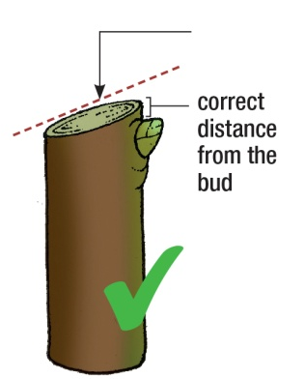
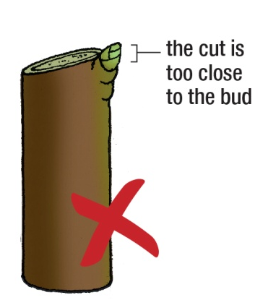
1. Pruning fruit trees
How to prune?
cut angled away from bud, not straight across
When making cuts, don’t leave a stub: cut close to the trunk or branch. Make pruning cuts just above an outward facing bud.
In the spring, this bud will grow away from the centre of the tree, opening it up.
!
Always use sharp tools for clean cuts. Dip tools in diluted household bleach in between each cut.
Notes:
When making cuts, don’t leave a stub: cut close to the trunk or branch.
Make pruning cuts just above an outward facing bud. In the spring, this bud will grow away from the centre of the tree, opening it up.
Always use sharp tools for clean cuts. Dip tools in diluted household bleach in between each cut.
Please see the leaflet for more information about pruning fruit trees.

Slide 6
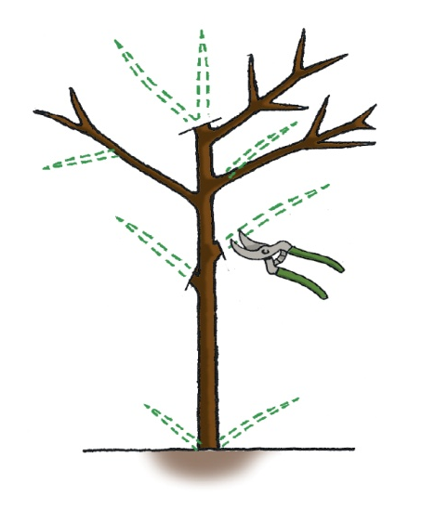
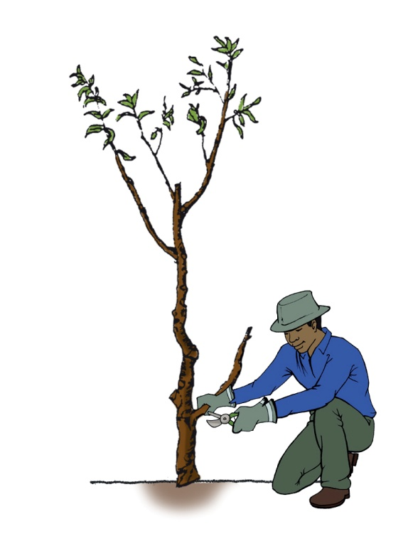
1. Pruning fruit trees
a. Steps in pruning fruit trees
1. Remove all the dead and diseased branches.
1. Remove any unnecessary limbs, including branches that cross over one another, are too close together or rub against each other.
Make the cut just above the collar.
2. Always cut away any branches growing below the union of grafted trees.
This is the root stock growing through and it will compete with the fruit growing part of the tree.
Notes:
Remove all the dead and diseased branches.
Remove any unnecessary limbs. This includes branches that cross over one another, are too close together or rub against each other. Make the cut just above the collar.
Always cut away any branches growing below the union of grafted trees. This is the root stock growing through and it will compete with the fruit growing part of the tree.

Slide 7
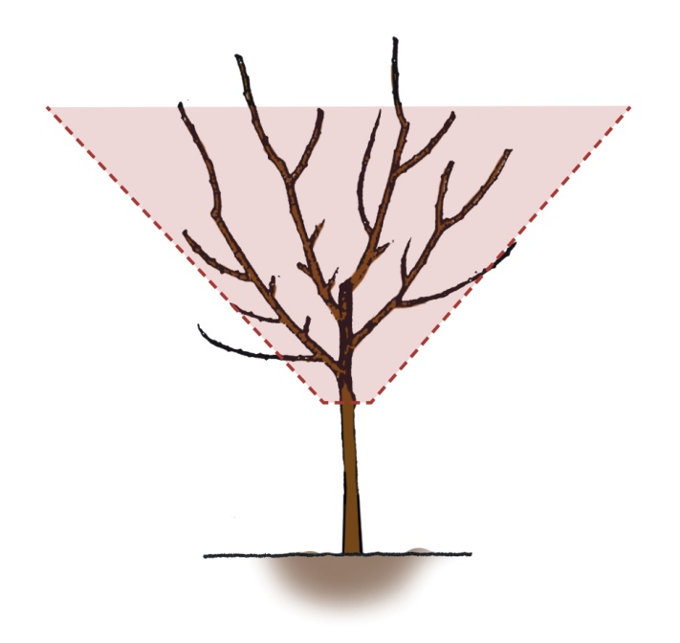
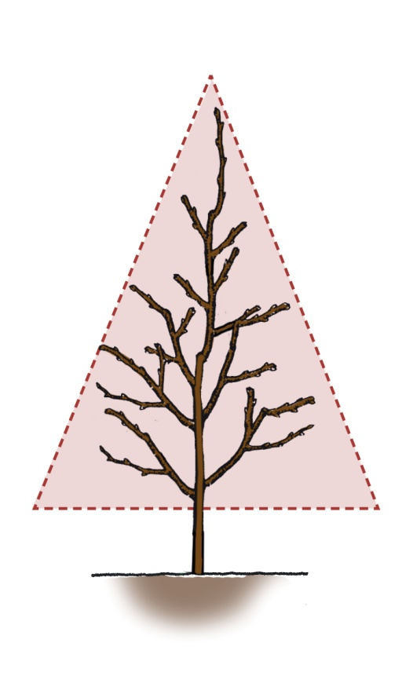
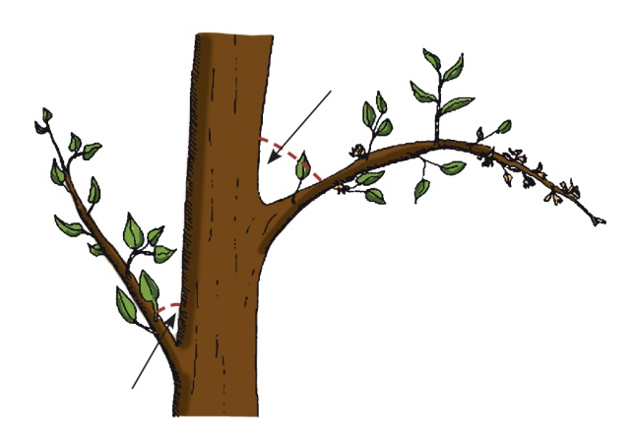
1. Pruning fruit trees a. Steps in pruning fruit trees
open centre (vase shape)
central leader
Fruit trees are generally pruned to either have open centres or to have central leaders (vase shape).
wide branch angle
Branches good for fruiting are at angles of 45-65 degrees off the main branches. Branches with smaller angles tend to break in high wind.
narrow branch angle
Keep one main vertical branch on a tree and promote angled branches to stimulate production of fruit rather than growth!
Notes:
Fruit trees are generally pruned to either have open centres or to have central leaders (vase shape).
Generally branches that are good for fruiting are at angles of 45-65 degrees off the main branches. Branches with smaller angles tend to break in high wind.
Only keeping one main vertical branch on a tree, together with promoting angled branches, stimulates production of fruit rather than more growth; the tree spends more energy producing fruit than trying to grow taller.
wide branch angle
narrow branch angle

Slide 8
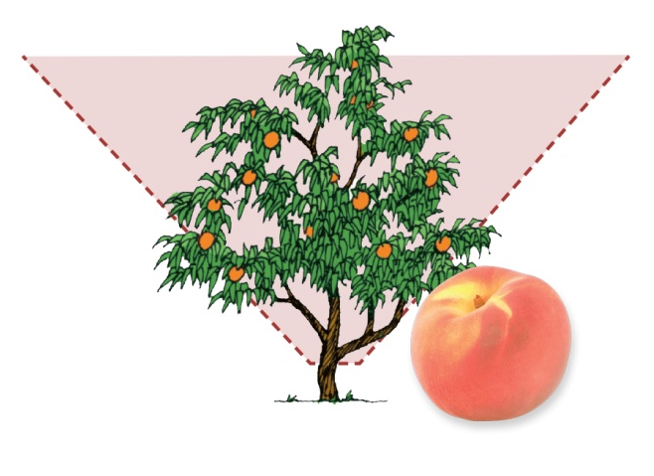
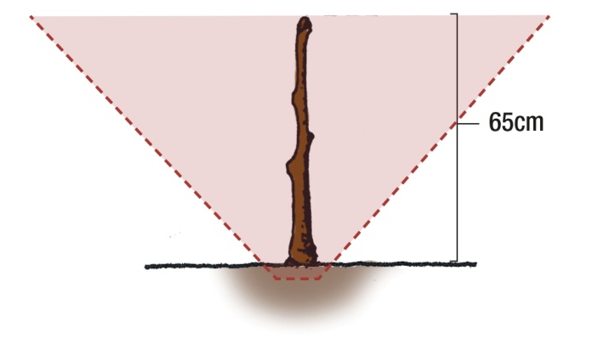
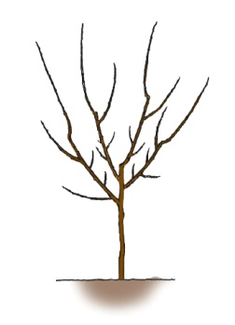
1. Pruning fruit trees b. Pruning stone fruit trees
To prune, it is also important to know how a tree fruits:
At planting
Prune the tree’s roots.
Also, prune the tree itself to about knee height (60cm), to force the tree to branch out rather than grow straight up.
In the first winter
Leave 2-3 laterals on each branch. The first lateral should be about 40cm from the main branch and the second further along.
Notes:
Pruning stone fruit trees
To prune, it is also important to know how a tree fruits:
1. At planting:
Prune the tree’s roots and also prune the tree itself to about knee height (60 centimetres). This will force the tree to branch out rather than grow straight up.
2. In the first winter:
Some laterals will have grown on the main branches. Leave 2-3 laterals on each branch; the first lateral should be about 40cm from the main branch and the second further along.

Slide 9
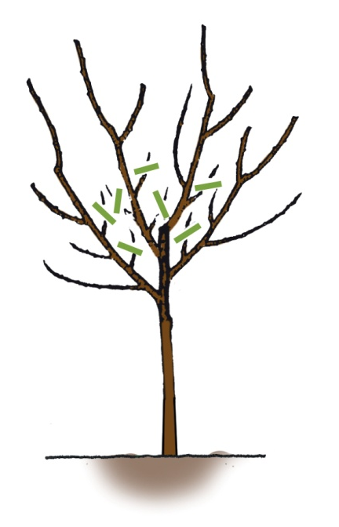
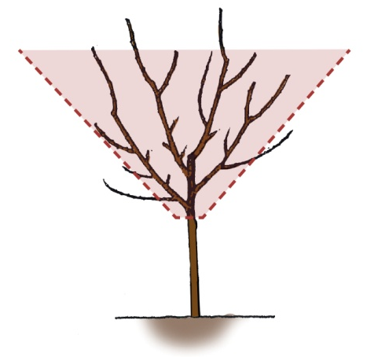
1. Pruning fruit trees b. Pruning stone fruit trees
From the second winter onwards
- Trim the tops of the main branches.
Do not cut them further back than the previous year’s growth or it will delay fruiting.
!
Shorten the laterals. Cut them:
1cm above a flowering bud OR
back to the join between old and new wood.
- Shorten the side branches coming off the laterals. Leave 2-3 side branches on each lateral.
Continue with these maintenance pruning practices every winter during the life of the fruit tree.
Notes:
3. From the second winter onwards:
Trim the tops of the main branches. If you cut them further back than the previous year’s growth, it will delay fruiting.
Shorten the laterals. Cut them 1cm above a flowering bud or cut them back to the join between the old and new wood.
Shorten the side branches coming off the laterals. Again leave 2-3 side branches on each lateral.
Continue with these maintenance pruning practices every winter during the life of the fruit tree.

Slide 10
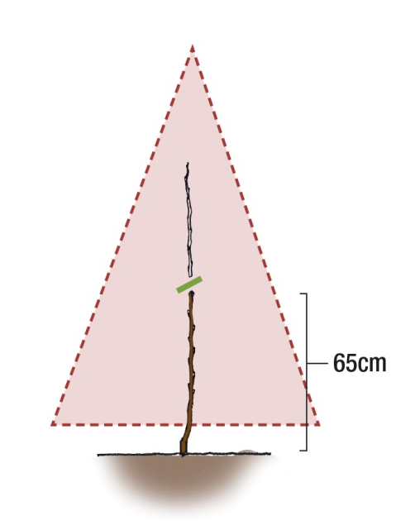
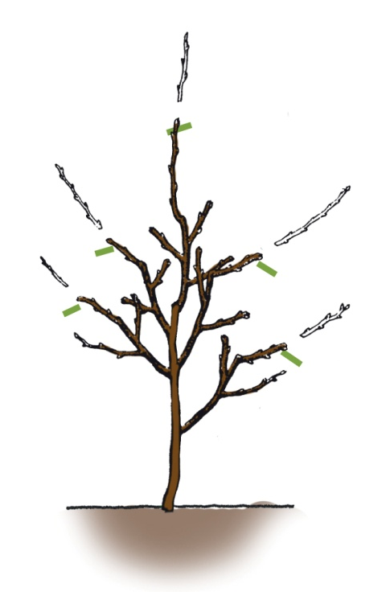
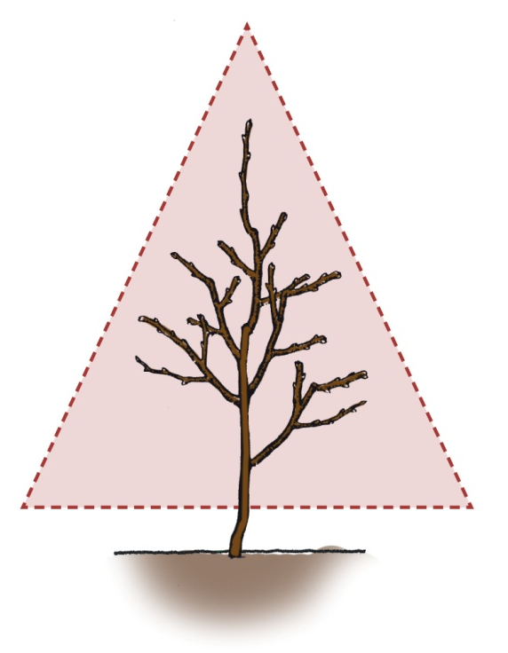
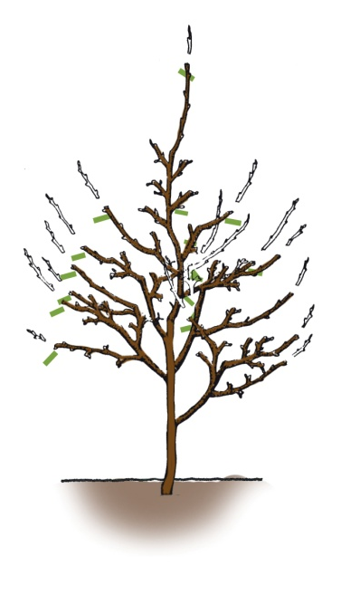
1. Pruning fruit trees c. Pruning pome fruit trees
First fruiting: around fifth season in the ground.
Pick fruits when green; they ripen off the tree.
1. At planting:
Cut the planted tree back to knee height.
2. In the first winter:
Trim the main branches, leaving one central branch. Leave 2-3 laterals on each main branch.
3. From the second winter onwards:
Trim the main branches and laterals and leave 2-3 branches coming off each lateral.
Notes:
These trees start fruiting around their fifth season in the ground. Fruit is picked green and ripens off the tree.
Generally a leader system of pruning has been preferred. Fruit grows on small side branches coming off the laterals and these side branches will bear fruit for many years.
1. At planting:
Cut the planted tree back to knee height.
2. In the first winter:
Trim the main branches, leaving one central branch. Leave 2-3 laterals on each main branch.
3. From the second winter onwards:
Trim the main branches and laterals and leave 2-3 branches coming off each lateral.

Slide 11
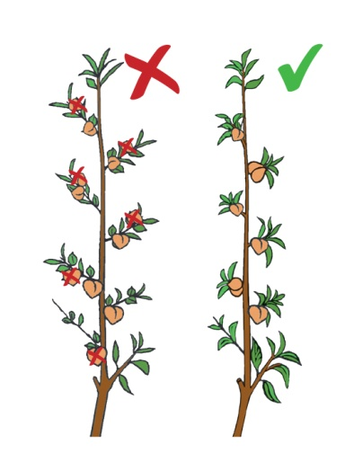
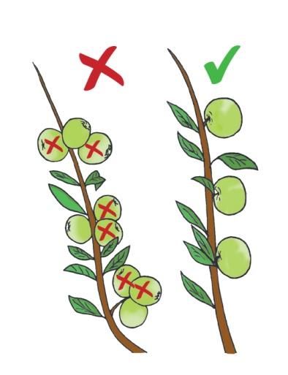
2. Thinning fruit trees
Why thinning?
- Too many fruits one year can lead to few/no fruits the next year.
Branches can break if they bear too many fruits.
Thinning ensures fewer but larger fruits rather than many small fruits.
How to thin?
Start thinning fruits 6-8 weeks after flowering when the fruits are the size of marbles, or small pebbles.
Stone fruits: peaches, plum, apricots
Pome fruits: apples and pears
Citrus: oranges, lemons, naartjies
Peaches and plums
Apples and pears
When thinning fruit trees, you should leave about 7-8 fruits per metre of branch, or about 4 fruits per arm’s length.
!
Notes:
In stone fruits (peaches, plum, apricots), pome fruits (apples and pears) and citrus (oranges, lemons, naartjies), a very heavy crop of fruit in one year can be followed by very few or none the next year.
Branches can also become too heavy and break if they bear too many fruit. It is thus a good idea to thin fruit on an overcrowded tree. This also ensures fewer, but larger fruits, rather than many small fruits.
Start thinning fruits 6-8 weeks after flowering when the fruits are the size of marbles, or small pebbles.
When thinning fruit trees, you should leave about 7-8 fruits per metre of branch, or about 4 fruits per arm’s length.

Slide 12
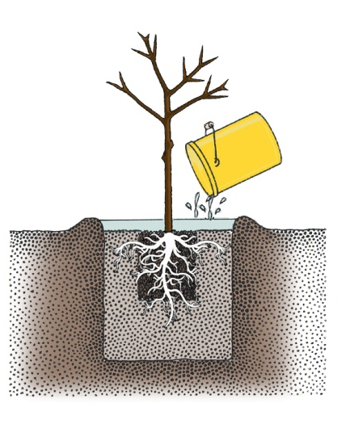
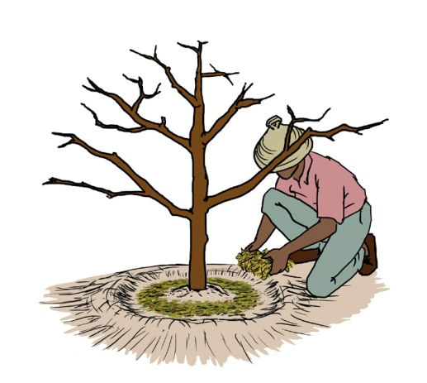
3. Effective fruit trees watering and care
- Deep rooted trees/plants: water deeply and less frequently.
Shallow rooted trees/plants: water less deeply and more often.
Build a watering basin to cover the root area
and direct water towards the roots.
- Use drip irrigation.
Use a mulch to conserve moisture:
organic material: compost, sawdust, bark, wood chips, straw
inorganic material: black plastic, stones
Organic mulch should not be in contact with tree trunks as constant moisture against the trunk promotes diseases.
!
Notes:
Water deeply and less frequently for deep rooted trees and plants.
Water less deeply and more frequently for shallow rooted trees and plants.
Build a watering basin to cover the root area and direct water towards the roots.
Use drip irrigation.
Use a mulch to conserve moisture.
You can use a layer of organic material such as compost, sawdust, bark, wood chips, straw OR it can be inorganic such as black plastic or stone.
Organic mulch should not be in contact with tree trunks as constant moisture against the trunk promotes diseases.
Mulch cools the soil in hot weather and prevents freezing in cold seasons.
Mulch prevents weeds and soil compaction.
It improves soil texture when it decomposes.

Slide 13
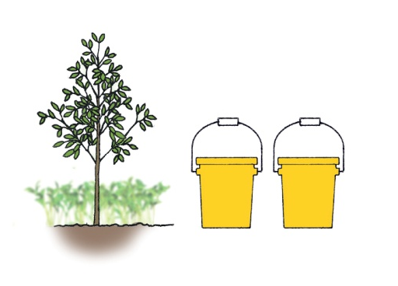
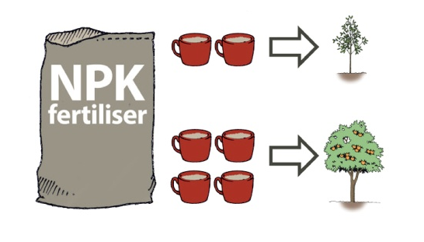
3. Effective fruit trees watering and care
- Fertilise well using manure, compost, or chemical fertilisers.
- 10 to 20 litres of well decomposed manure or compost should be added for young trees.
- If the compost is of poor quality, add 4 cups of NPK fertiliser per mature tree and 2 cups per young trees.
Mulch:
- Cools soil in hot weather
Prevents freezing in cold seasons
- Prevents weeds and soil compaction
- Improves soil texture when it decomposes
Notes:
Fertilise well using manure or compost, or with chemical fertilisers.
10 to 20 litres of well decomposed manure or compost should be added for young trees.
Additional fertilisation with chemical fertiliser can be done if the compost was of poor quality: 4 cups NPK fertiliser per mature tree and 2 cups per young trees.

Slide 14
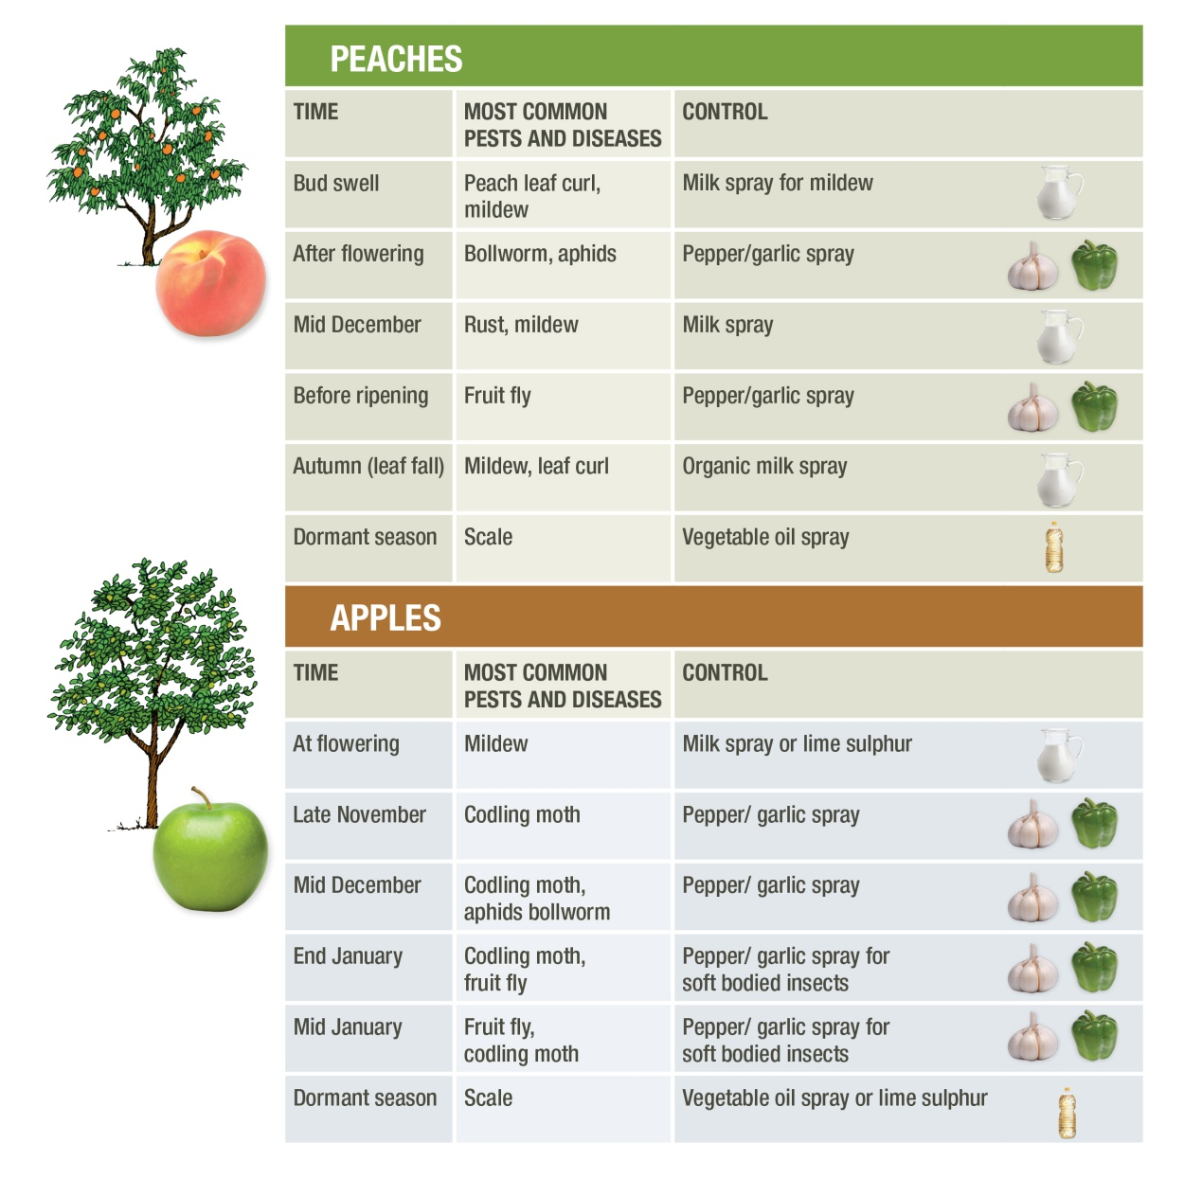
4. Pest and disease control
Control tips for common fruit tree diseases and pests
Notes:
The organic remedies for vegetables can also be effectively used for control of pests and diseases in fruit trees.
A good balance of intercropped plants will assist in pest control creating a balance between existing insects and predators.

